Slide 1
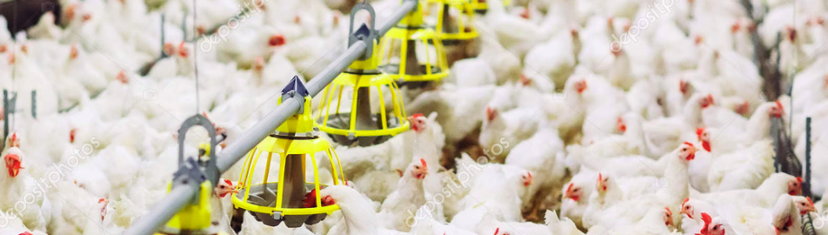

Monitoring antimicrobials in livestock production

Slide 2
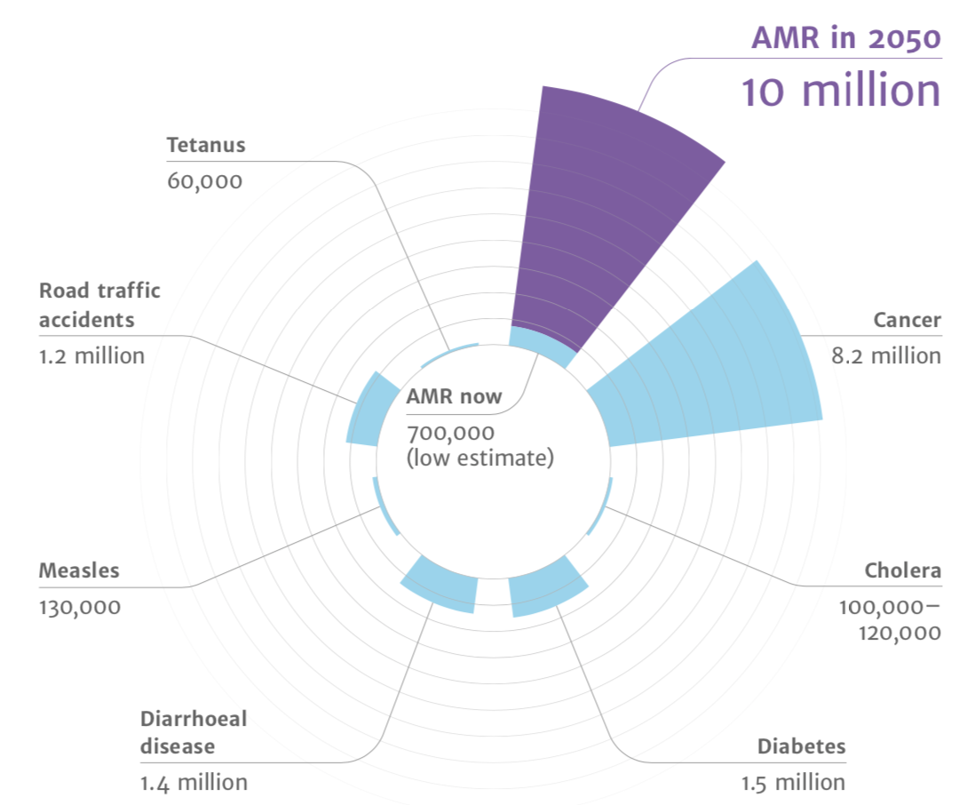
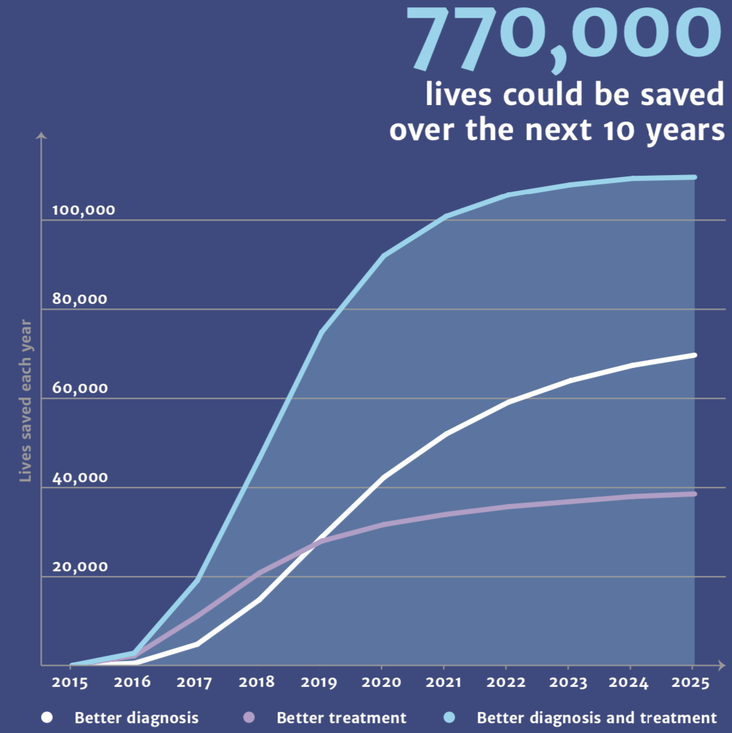

https://resistancemap.cddep.org/AntibioticResistance.php

Slide 3
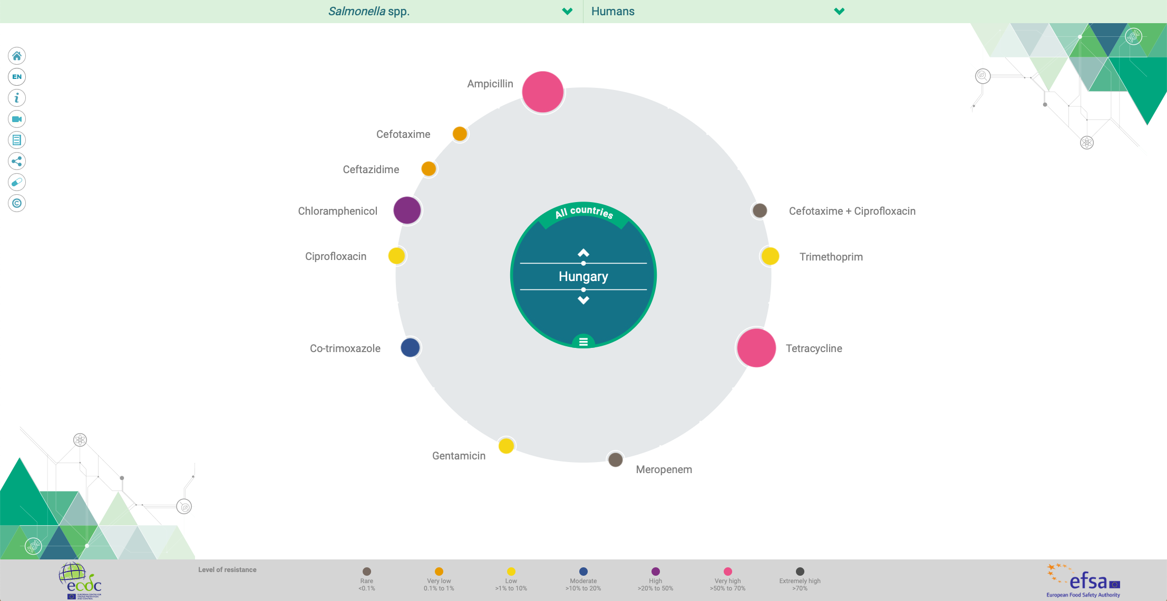
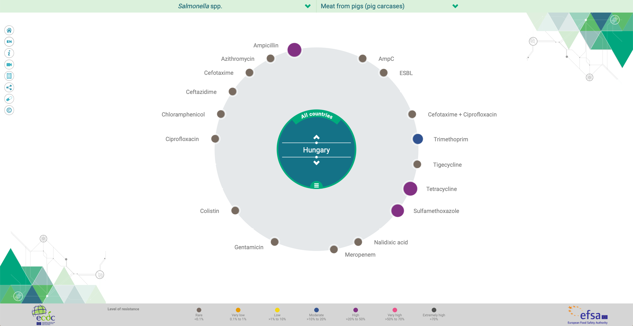
https://www.efsa.europa.eu/en/interactive-pages/AMR-Report-2017

Slide 4
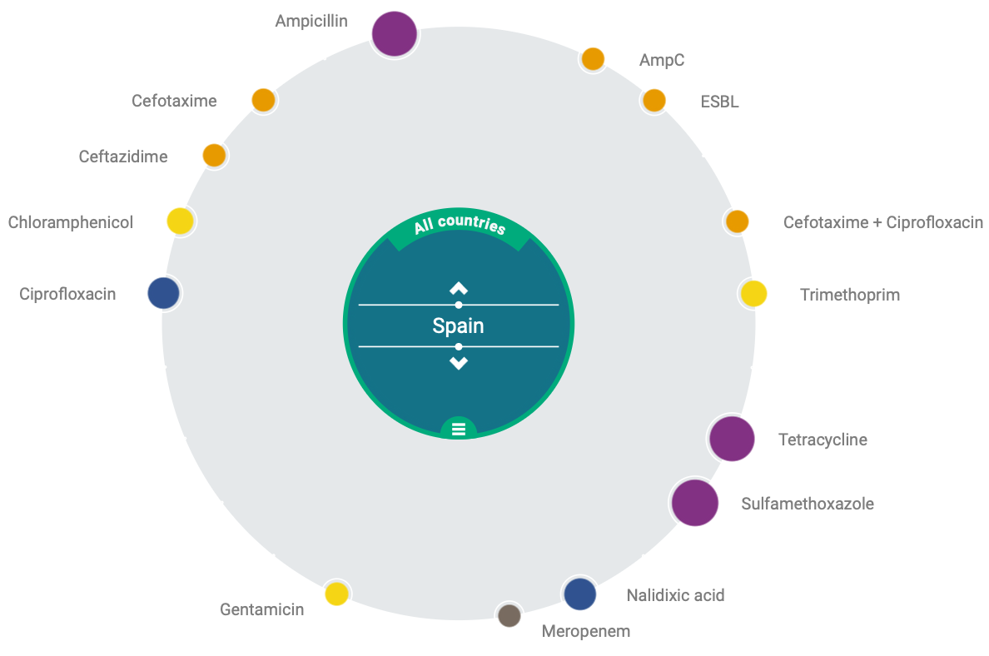
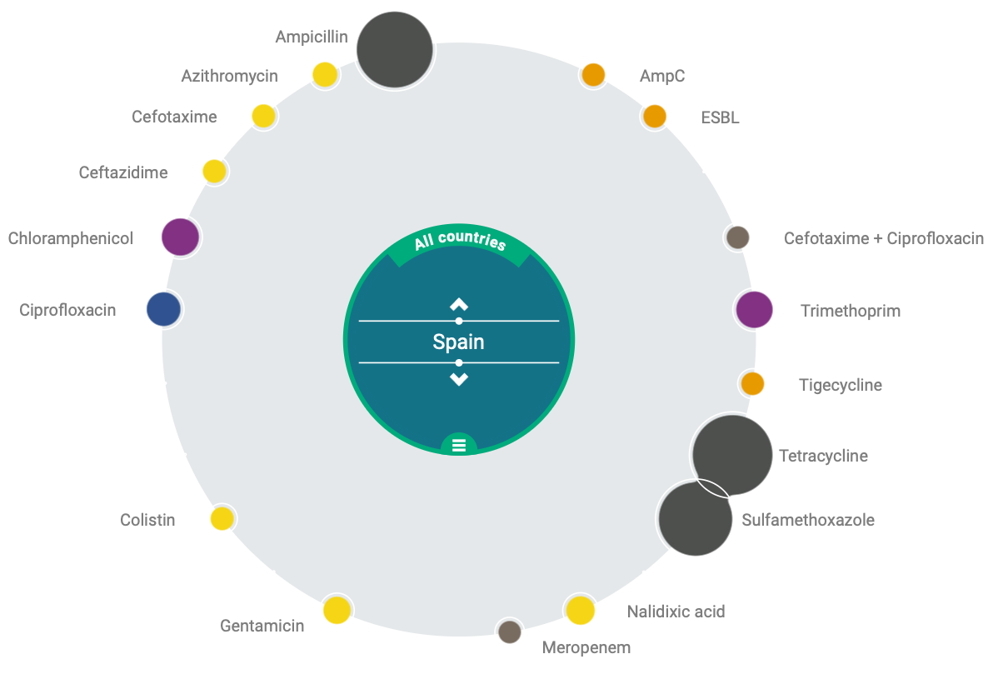
https://www.efsa.europa.eu/en/interactive-pages/AMR-Report-2017

Slide 5
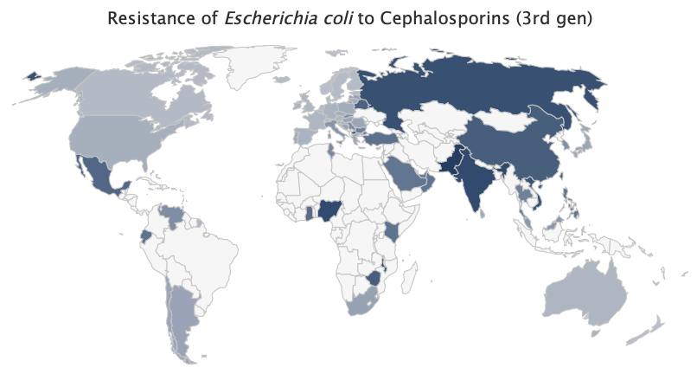

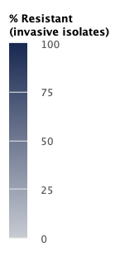

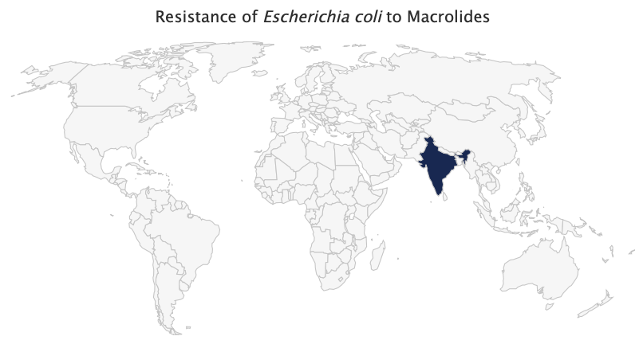
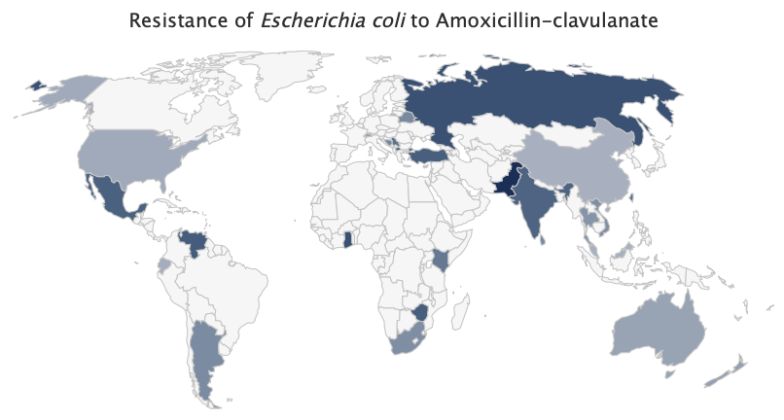
https://resistancemap.cddep.org/AntibioticResistance.php

Slide 6

How can you use Livestocker to fight against AMR?

Slide 7
Theory
High
Low
Regular
Incidence of management failure
Nutrients are essentials, composition has no influence on performance
Nutrients and composition both are essentials for good performance
Medium
Feed additives to improve health
Low
Average
Robustness and health status
Moderate
Antimicrobial use
High
Incidental

Slide 8
Focus areas to reduce antimicrobial use
Hygiene – Disease control
Data management & analysis
Pathogen survey / map
Cleaning - disinfection
Entry points
Bedding (microbiology) - flooring
Antibiotic consumption
Feed- & water disappearence
Environment parameters
History & trends analysis
Continuous seek for correlations
Water
Robustness of breeds & health
Critical points
pH – microbiology - biofilm
Temperature
Mineral content
Water flow
Choice of breeds
Young animal nutrition
Vaccination program - prevention
Feed
Housing - technology
Density m² and m³
temperature, humidity
Air speed
Flooring – bedding (quality)
Raw materials – Quality control
Digestibility
Mineral content
Physical properties
Feeders and feeder space
Preservation, Hygiene in mill and farm

Slide 9

What does happen with the farm data today?
A
B
NOTHING
...There is nobody to analyze it in structure
NOTHING
...No time to analyze or structurise

Slide 10
Production
Strategy
Real time information
Barn log book
Treatment log book
Production performance
Feed consumption
Integrated production system
Raw material management
Integrated system
Volatile market
Scenario Planning
Customers
Suppliers
Performance indicator
Financial reports, indicators
Periods – History - Trend
Benchmark
Efficiency control
Antimicrobial monitoring
Real time profit & loss
Outstanding
Liabilities
Livestock value
Monthly reports (internal & authorities)
Interpretation
Financials

Slide 11
No specific requirement for hardver
WEB BASED
Run on any browser
No need to install
SAFE
IBM Cloud
Microsoft Azure
01
02
AVAILABLE 24/7
Anywhere – anytime thru internet
User rights
APPLICATION
Recording data
Quick dashboard
03
04

Slide 12


CLOUD

Slide 13
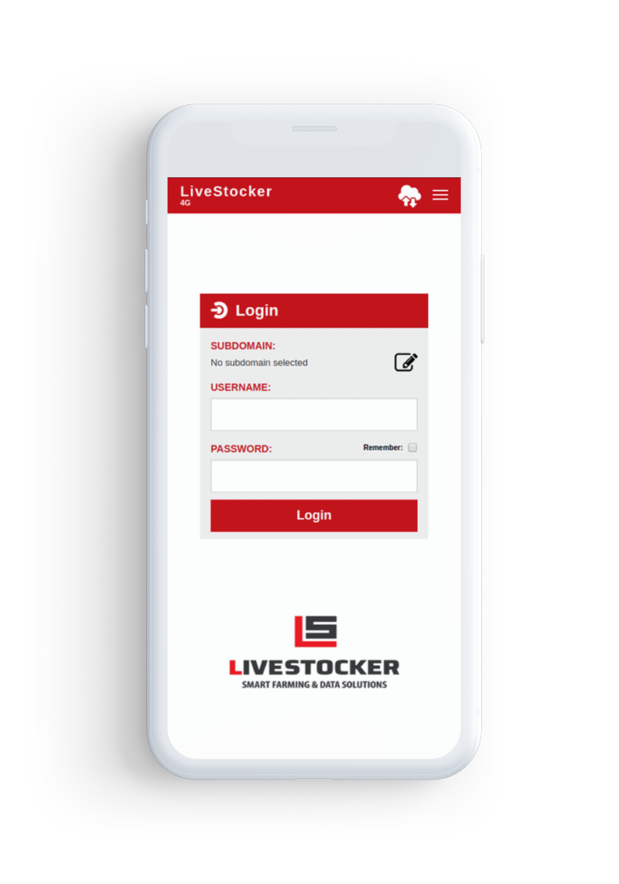

Application
No specific requirement for hardver & software
  IOS
  Android
Recording data
  Only those events which may have happened
Offline - synchronization
Hundreds of events can be recorded before synchronization

Slide 14
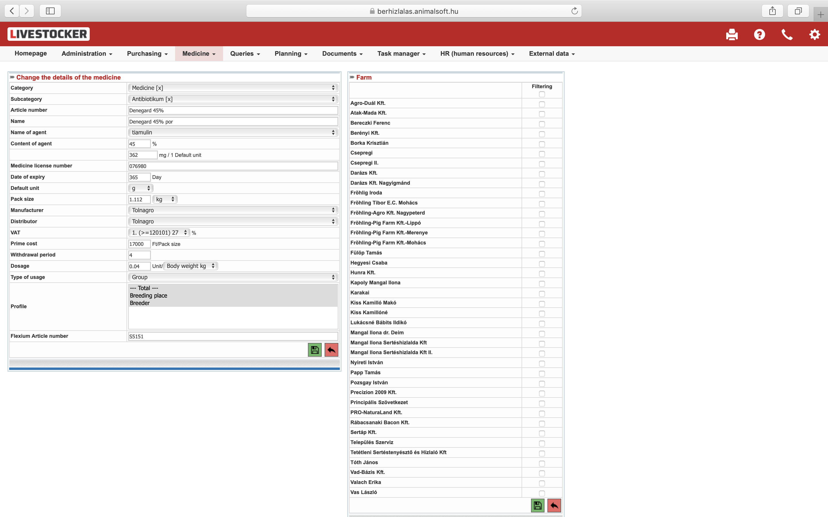
Master data
Brand
Active ingredient
Concentration
Approval ID
Dosage
Expiry date
Size, packaging (ml, kg)
Producer
Distributor
Cost
Withdrawal period
Purpose of application
Item number internal
Farm specific
User rights

Slide 15
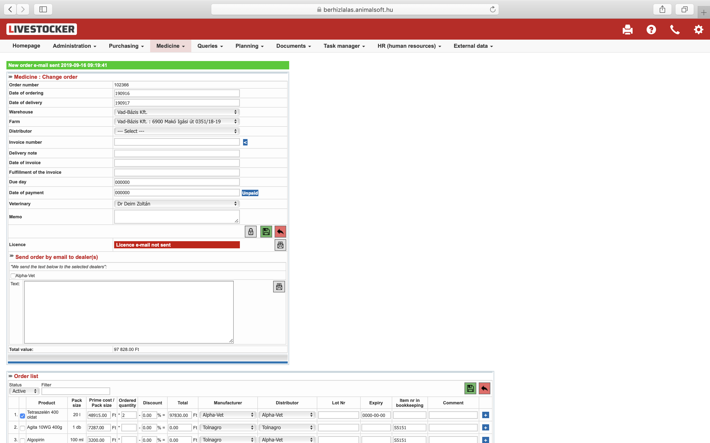
Orders
ID’s
  Number
  Dates
  Shippment
  Warehouse / Farm
Distributor
Delivery notes
Date of issued / payment term
Due date
Paid at date
Veterinary
Memo
Authorizations / approvals
List of orders with filters

Slide 16
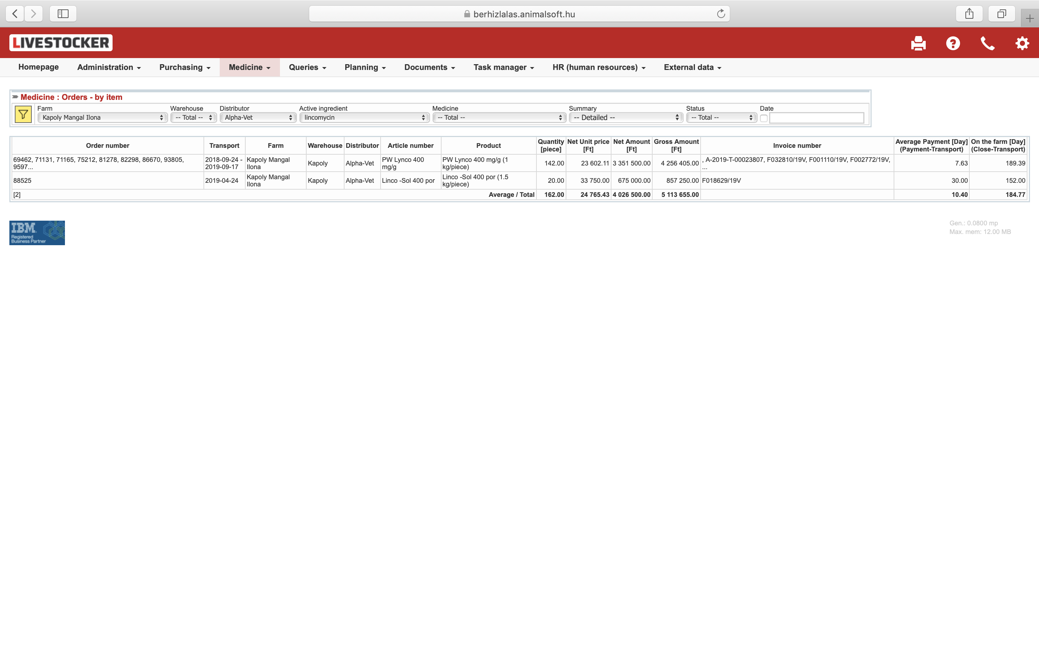
Orders by item
Filters
  Farm
  Warehouse
  Distributor
  Active ingredient
  Brand
  Status
  Date

Slide 17
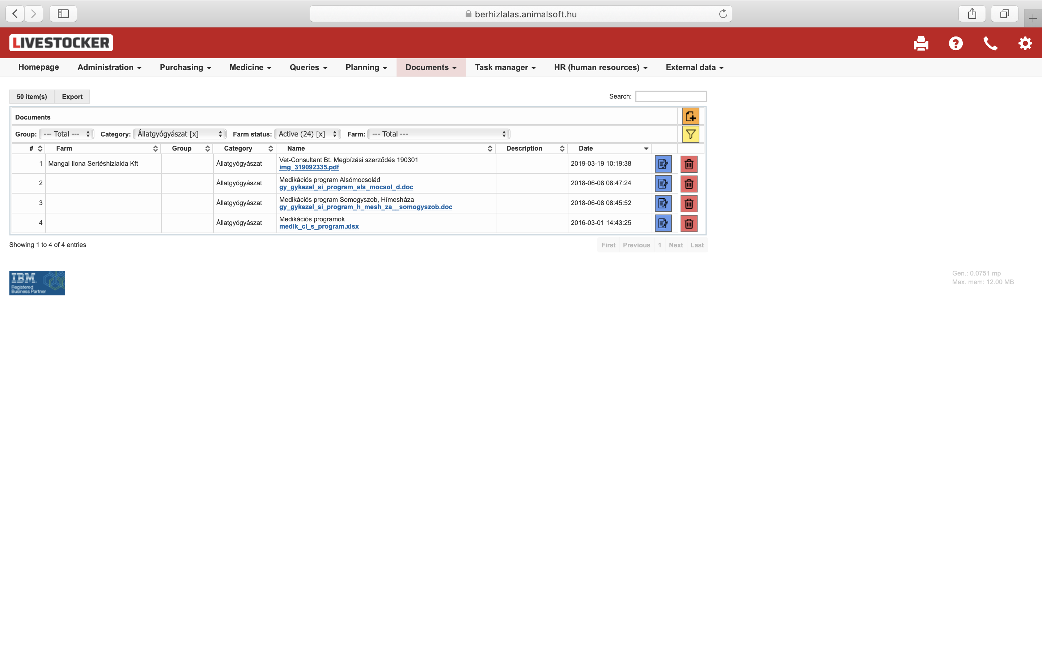
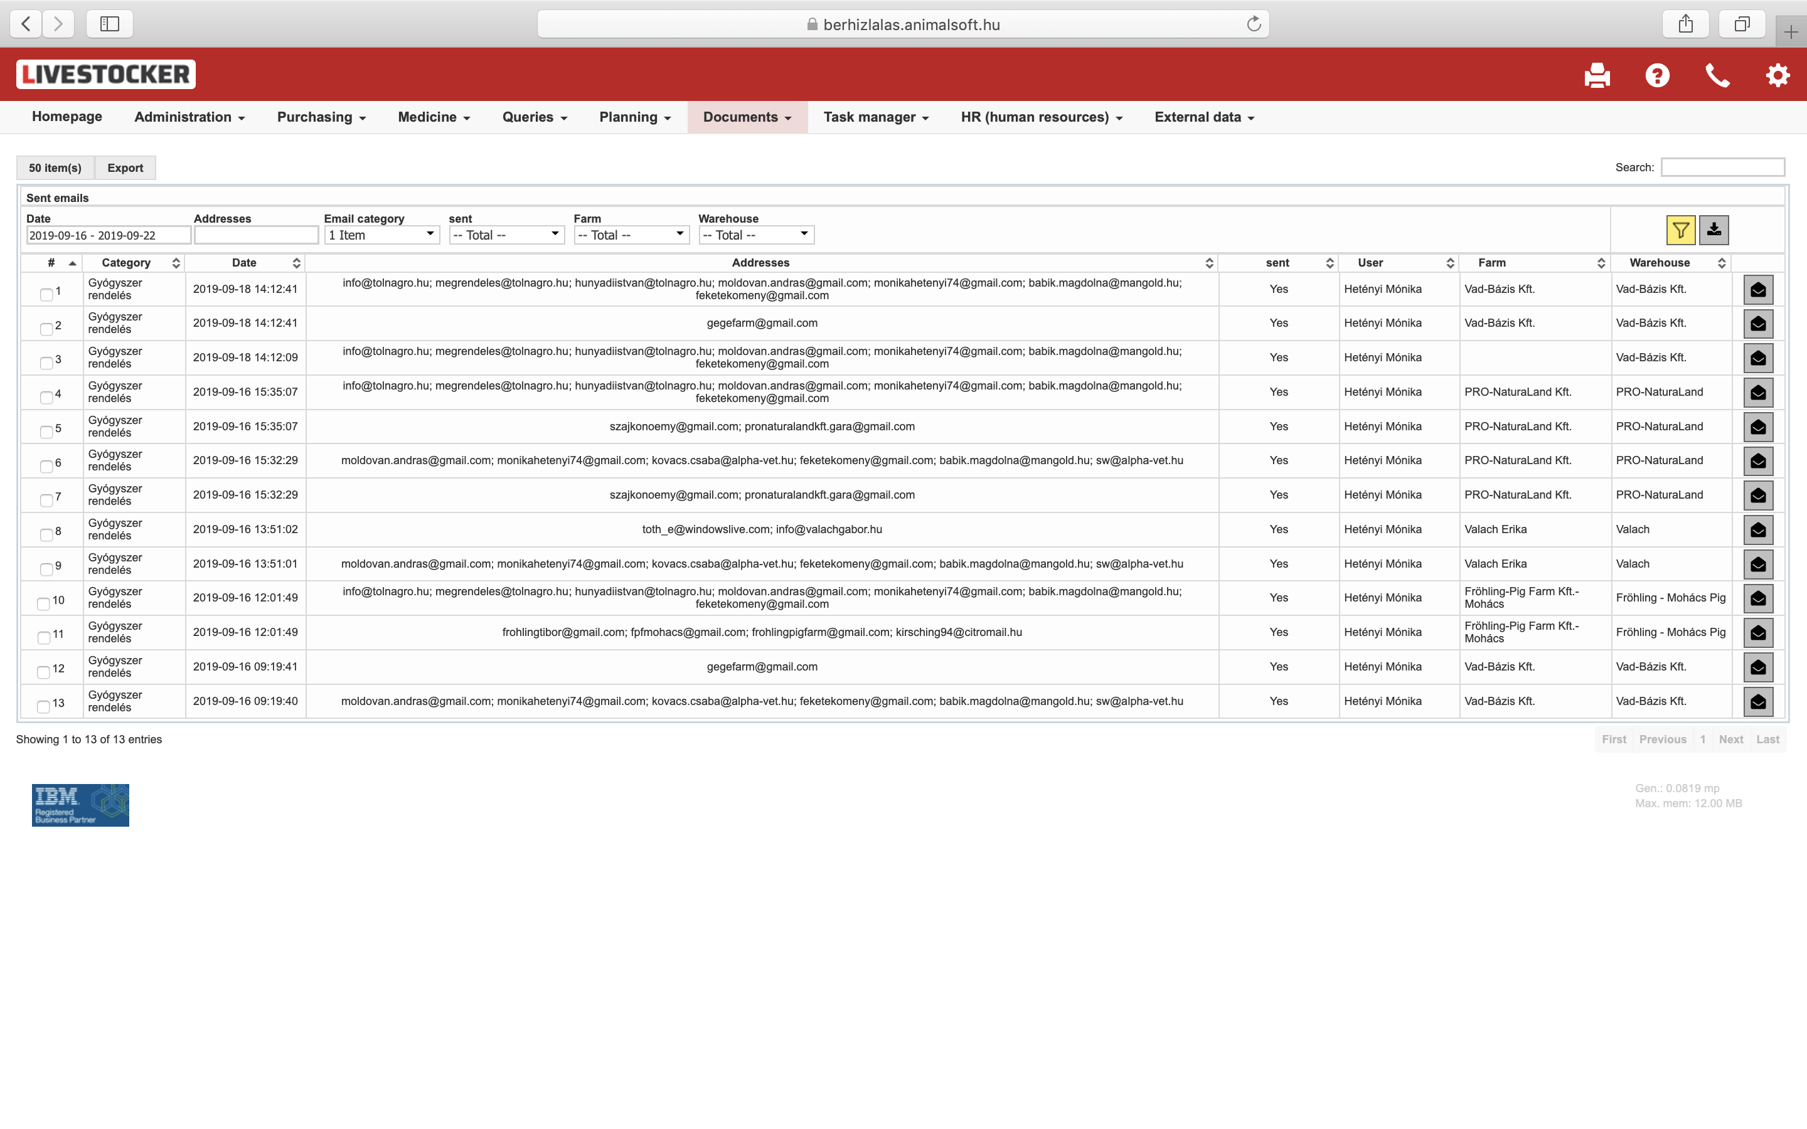
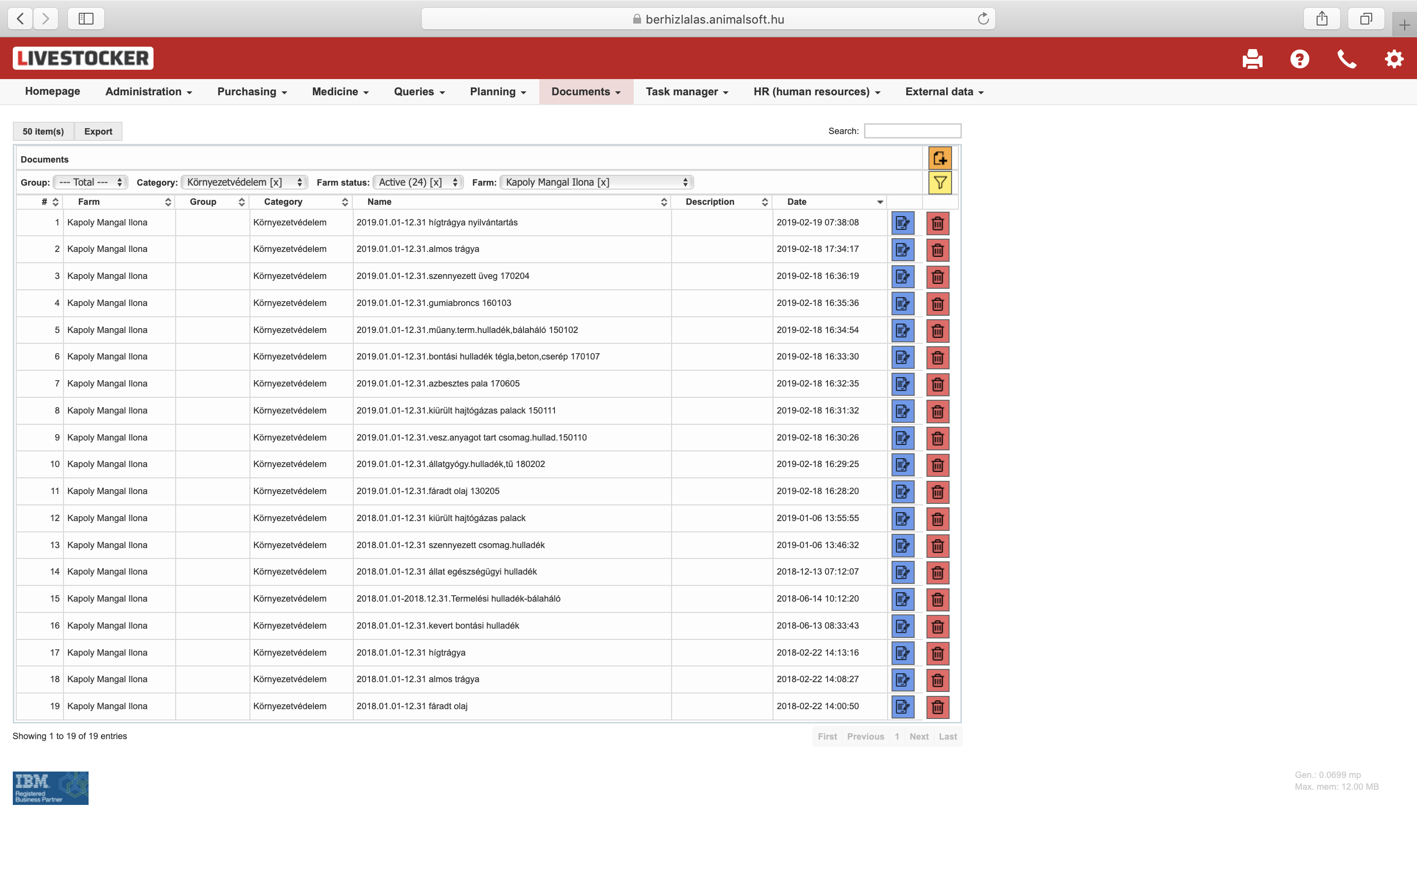
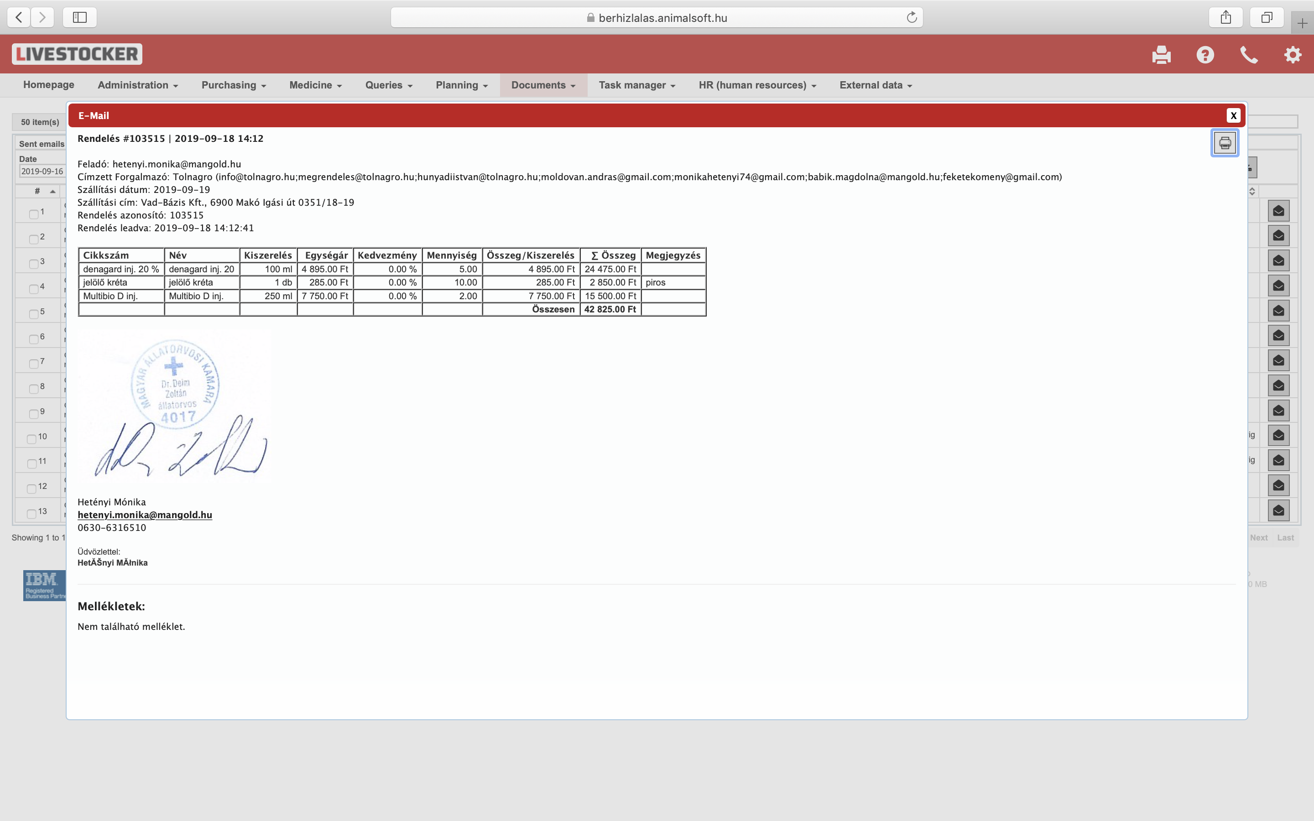
Documents
Categories eg.
  Animal health
  Environment
Organized
Filters
Immediate access
E-mail
Categories
Organized
Filters
Immediate access
Online prescription
Format of prescription can be adjusted according to local legislation

Slide 18
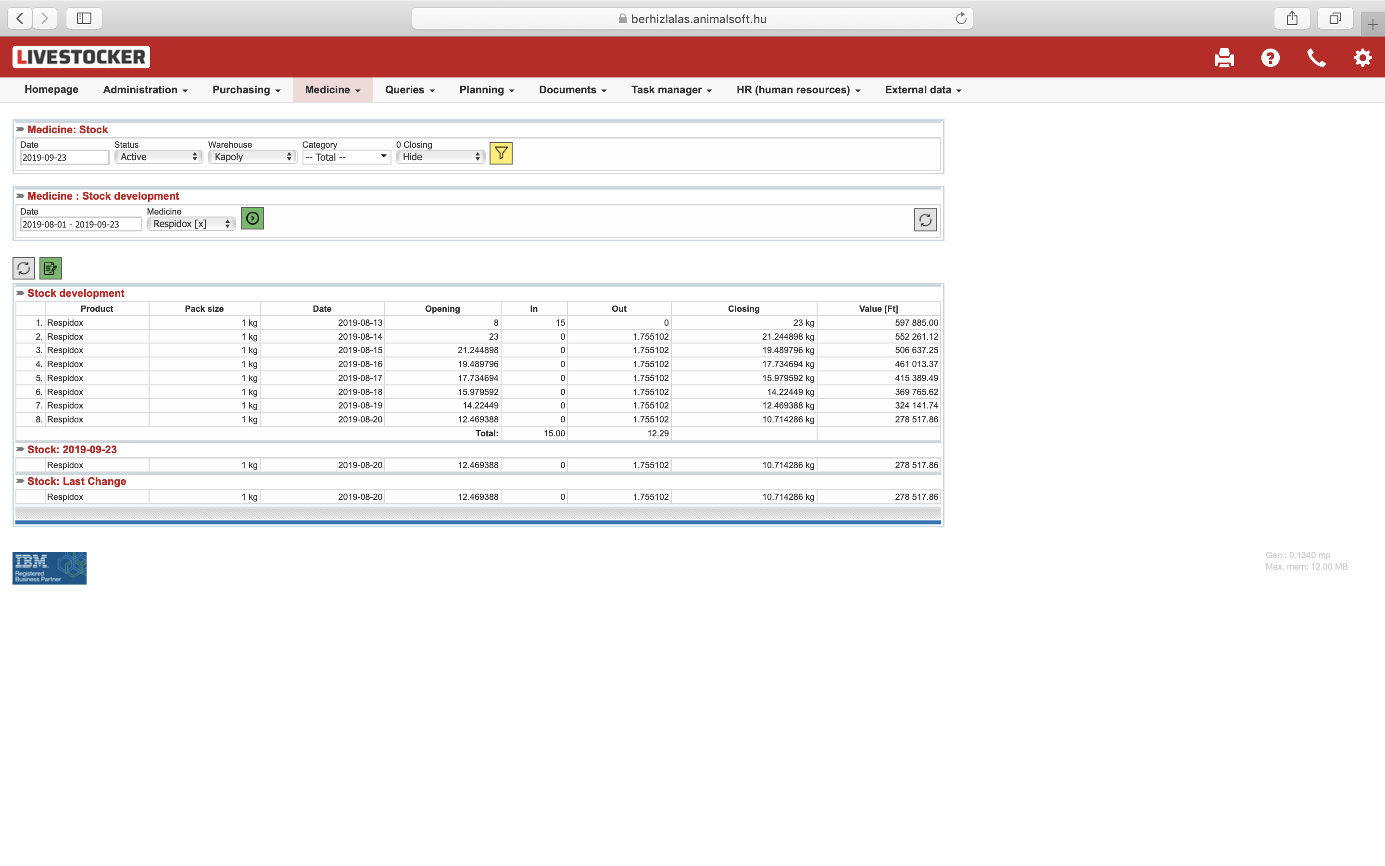
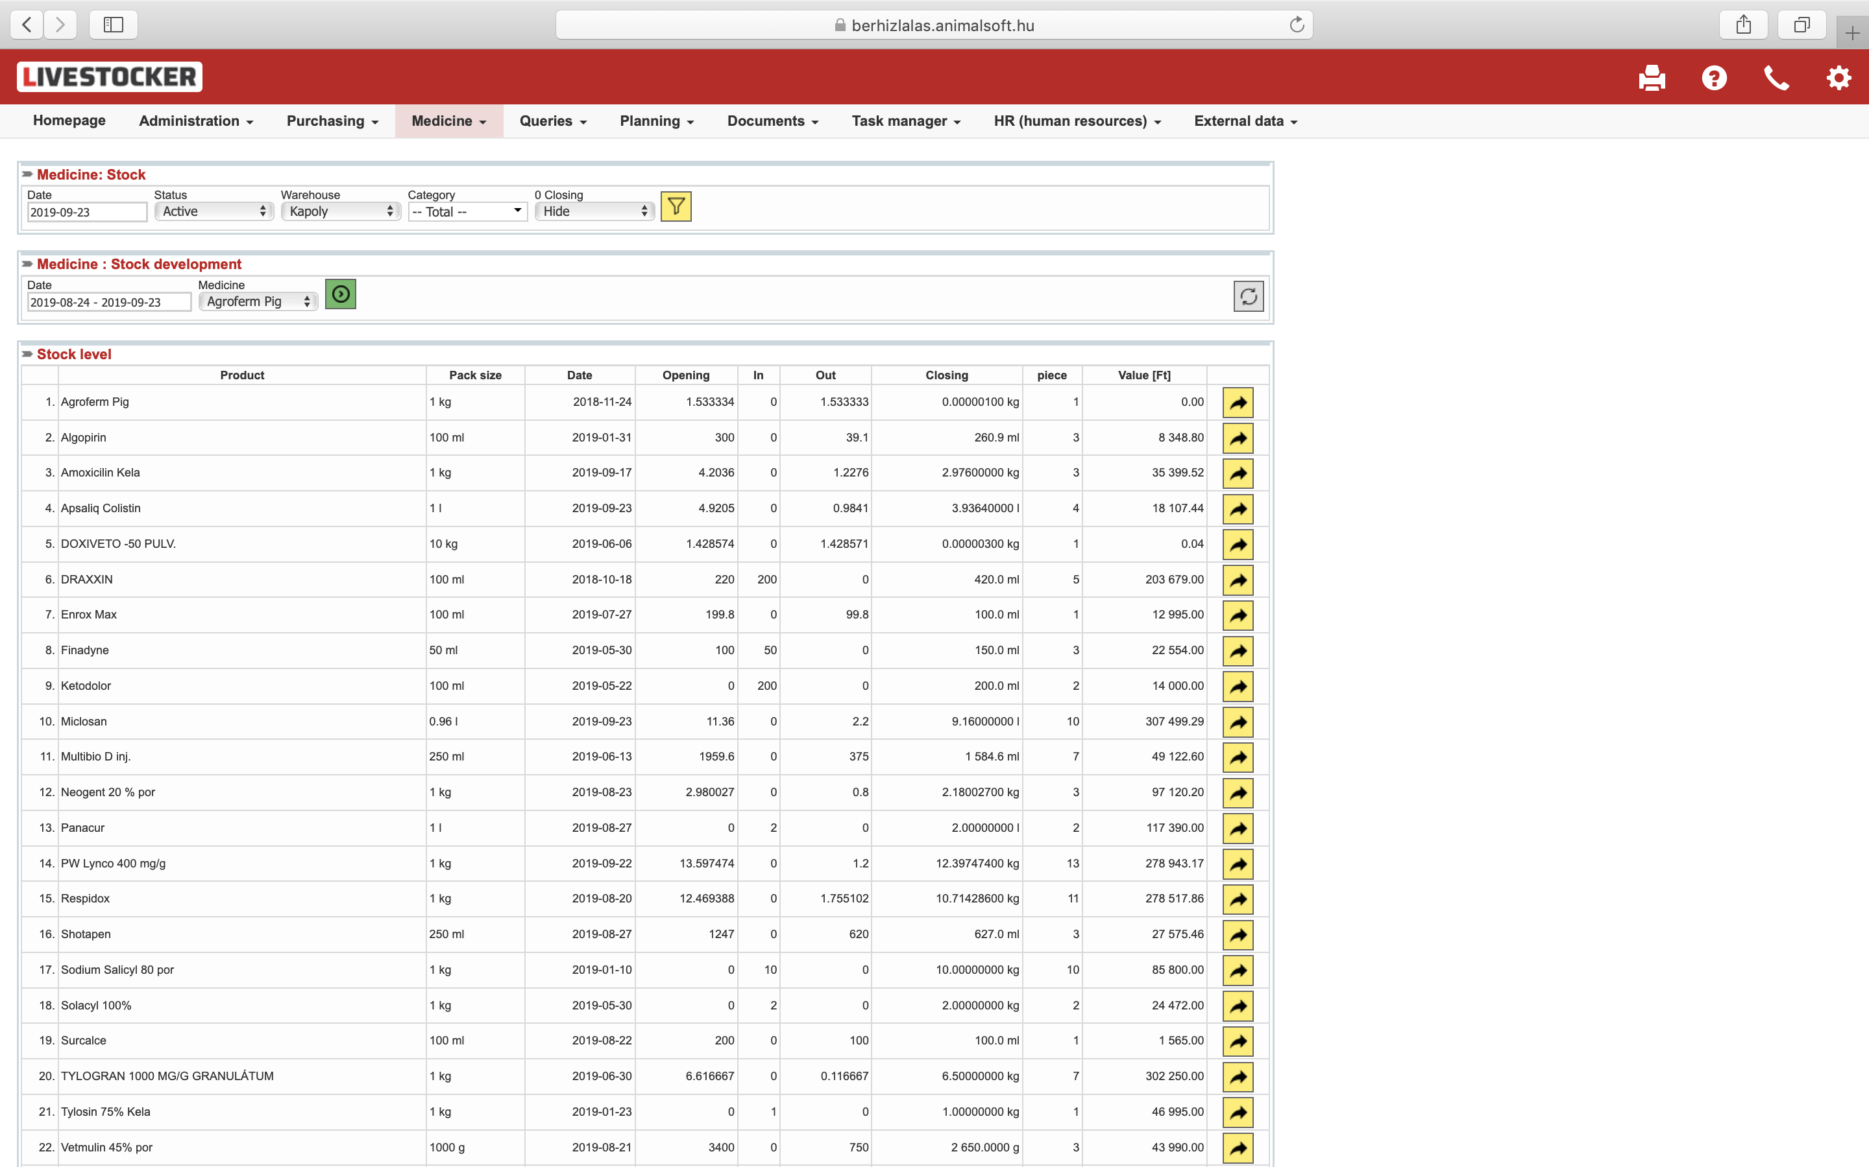
Stock
Date
Warehouse
Category
Stock development
Period
(In / Out)
Value

Slide 19
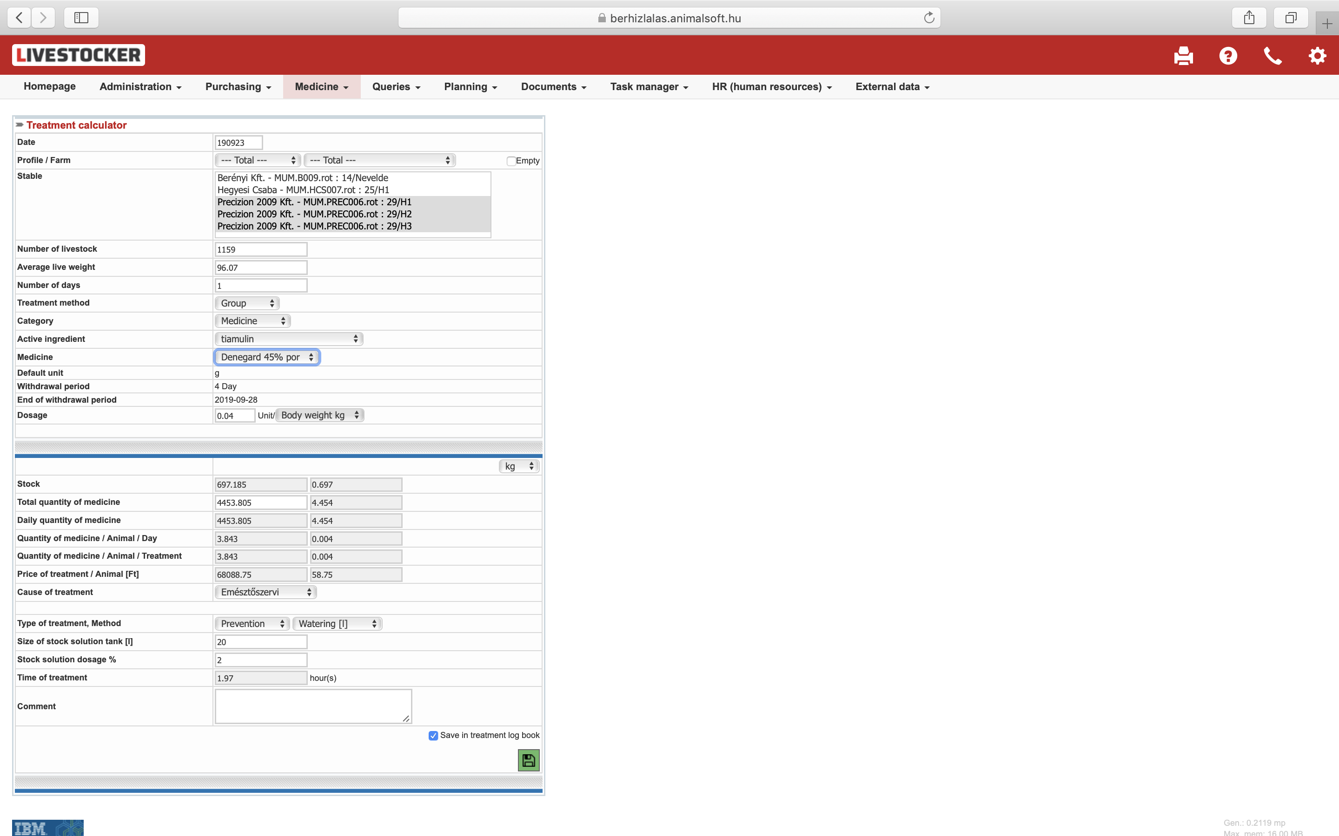
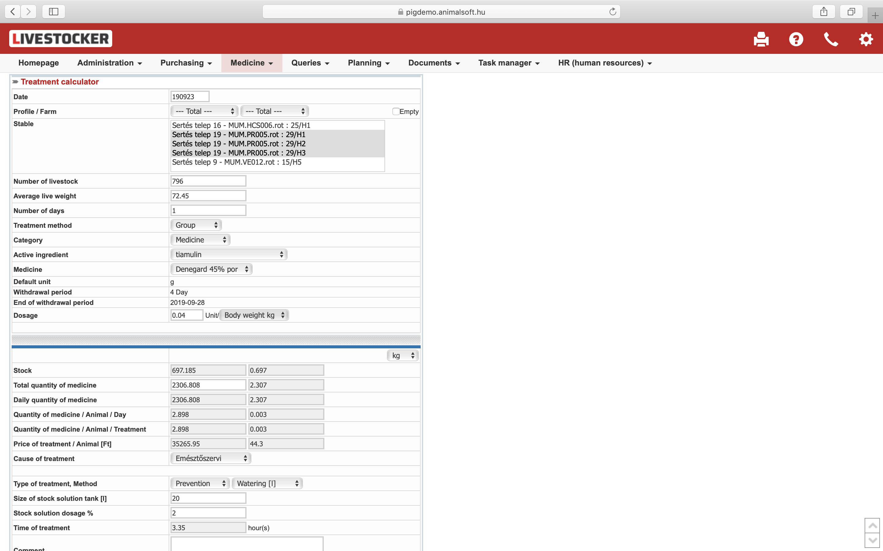
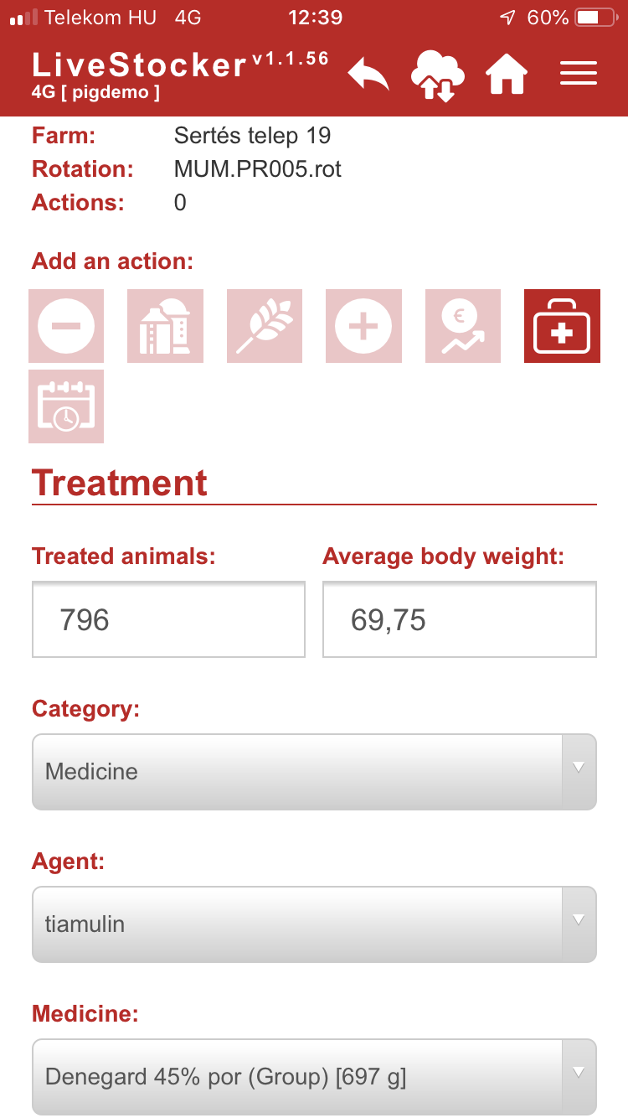
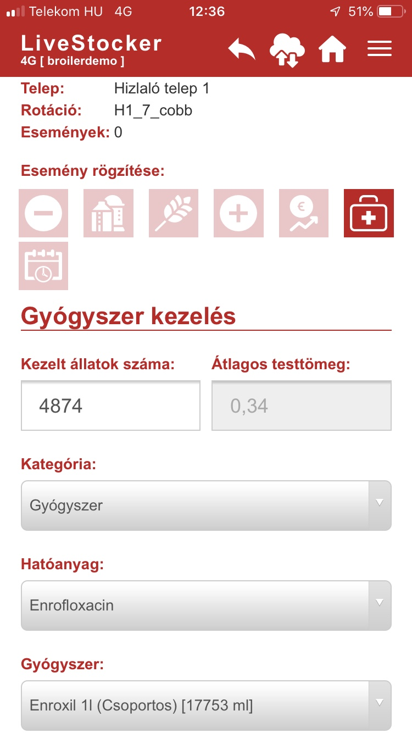
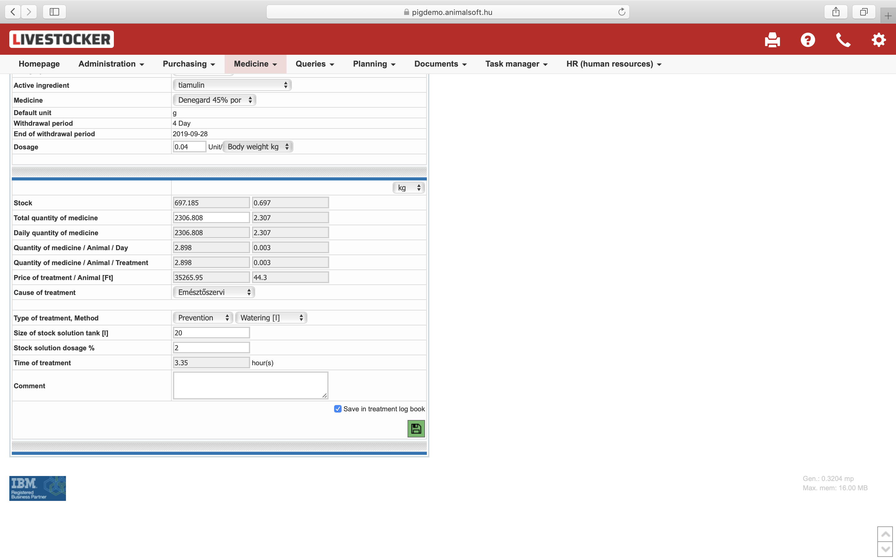
Treatment calculator
Application and software
Nr of animals picked up automatically from data
Weight automatically picked up from body mass table
Both can be changed
Type of treatment
Active ingredient
Medication
In case no stock, cannot be used
Orders from application
Log book automatically
Stock reports

Slide 20
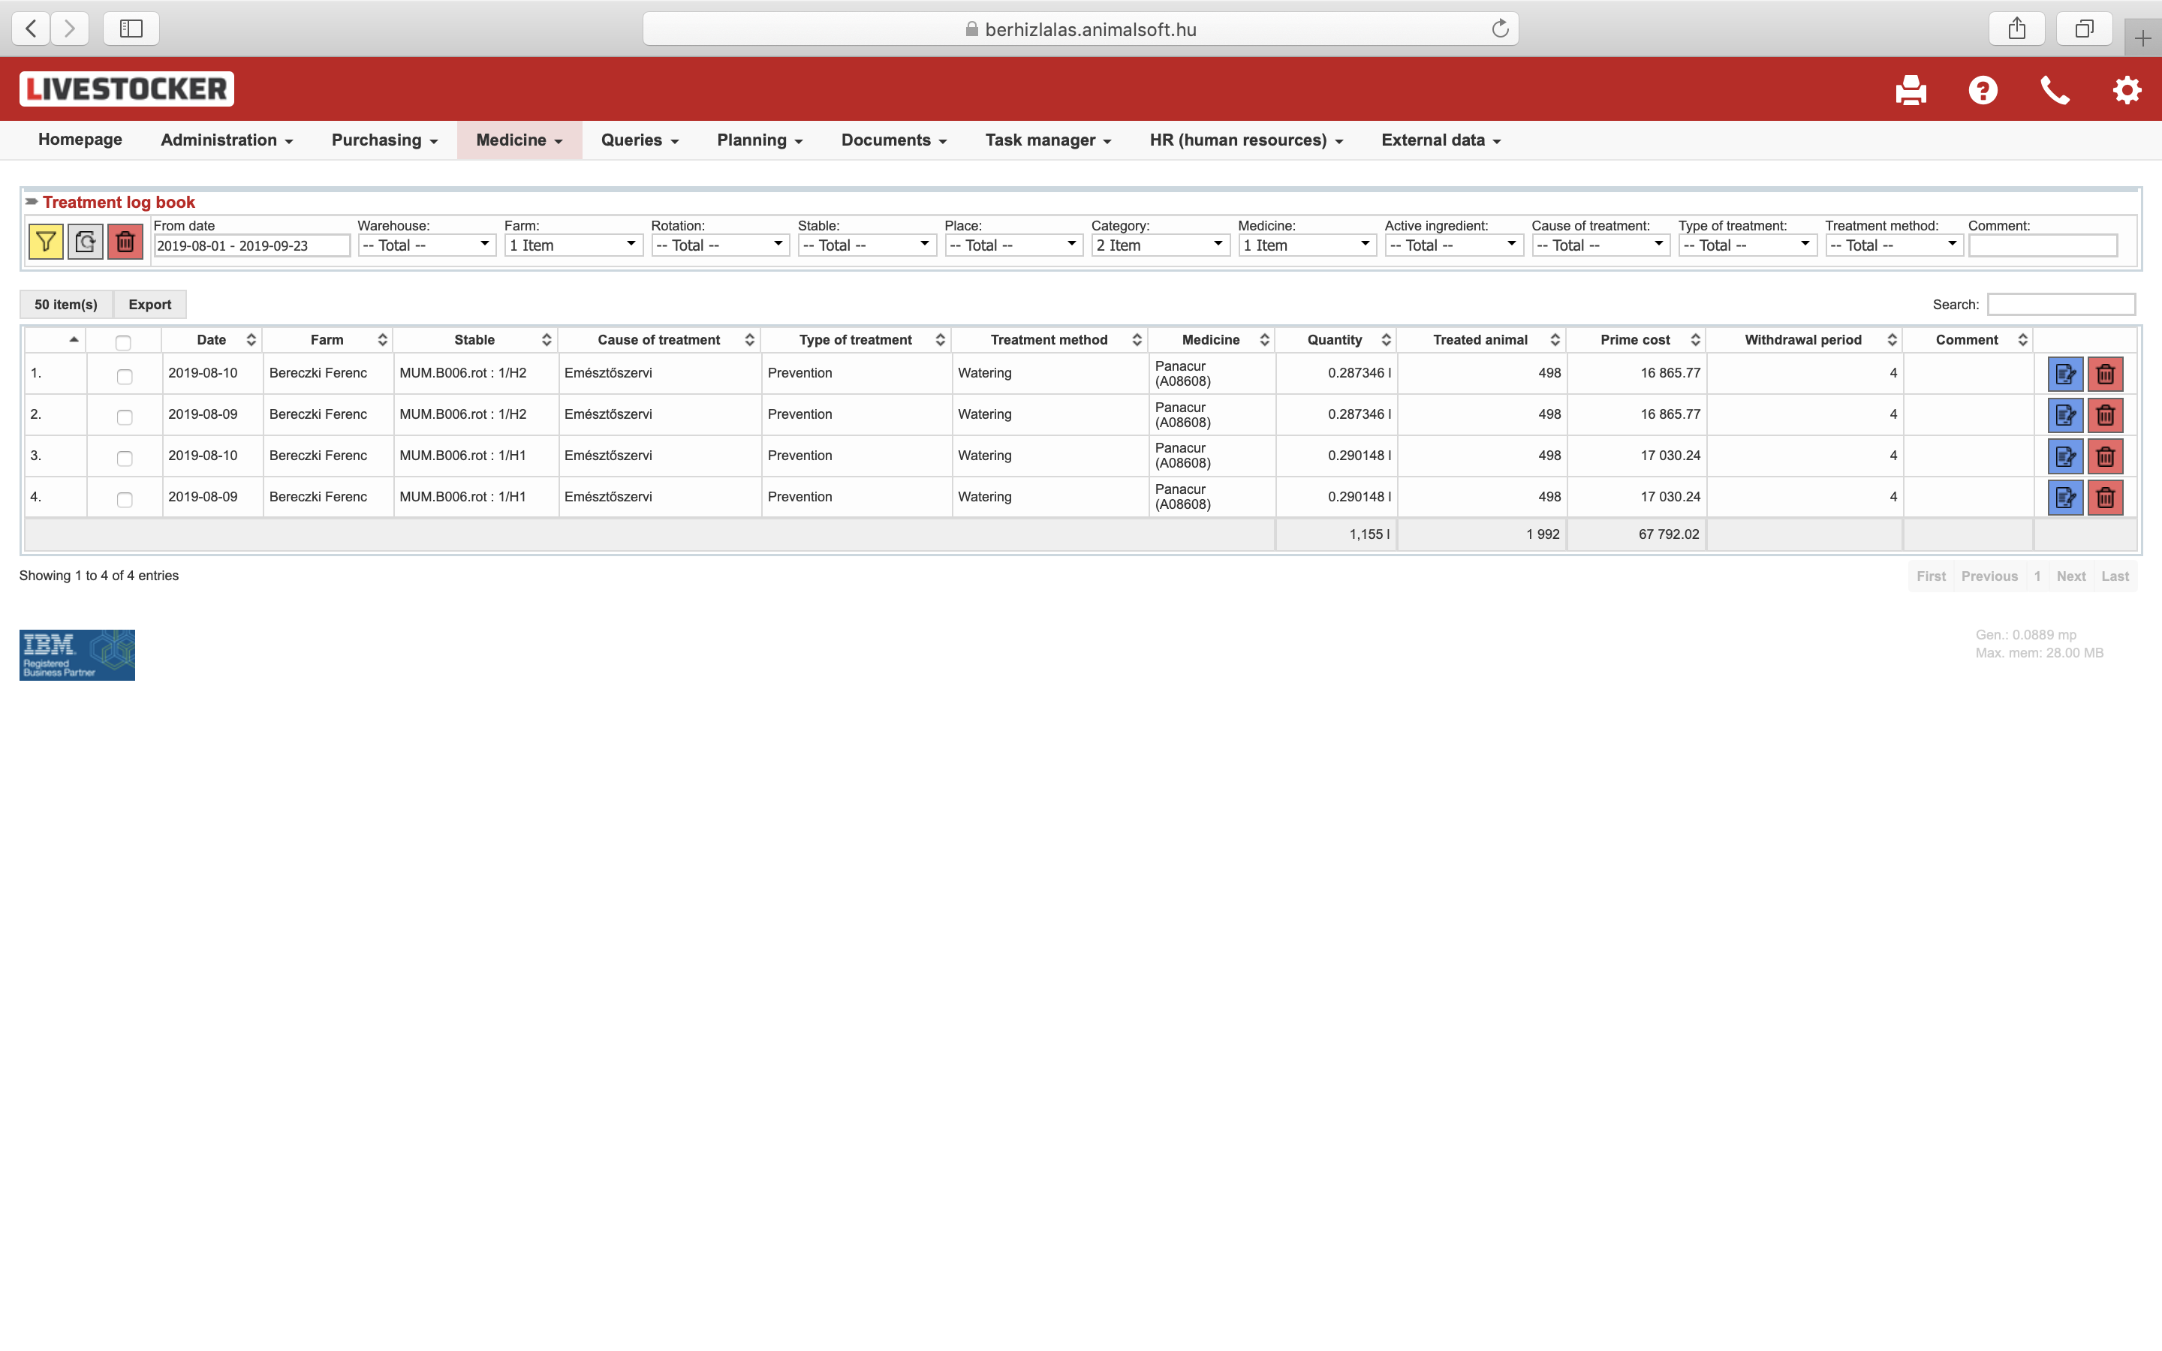
Log book
Generated from treatments
Lists
  Period
  Farm
  Rotation
  Stable
  Med category
  Product / Medicine
  Active ingredient
  Treatment
    Cause
    Type
    Mode

Slide 21
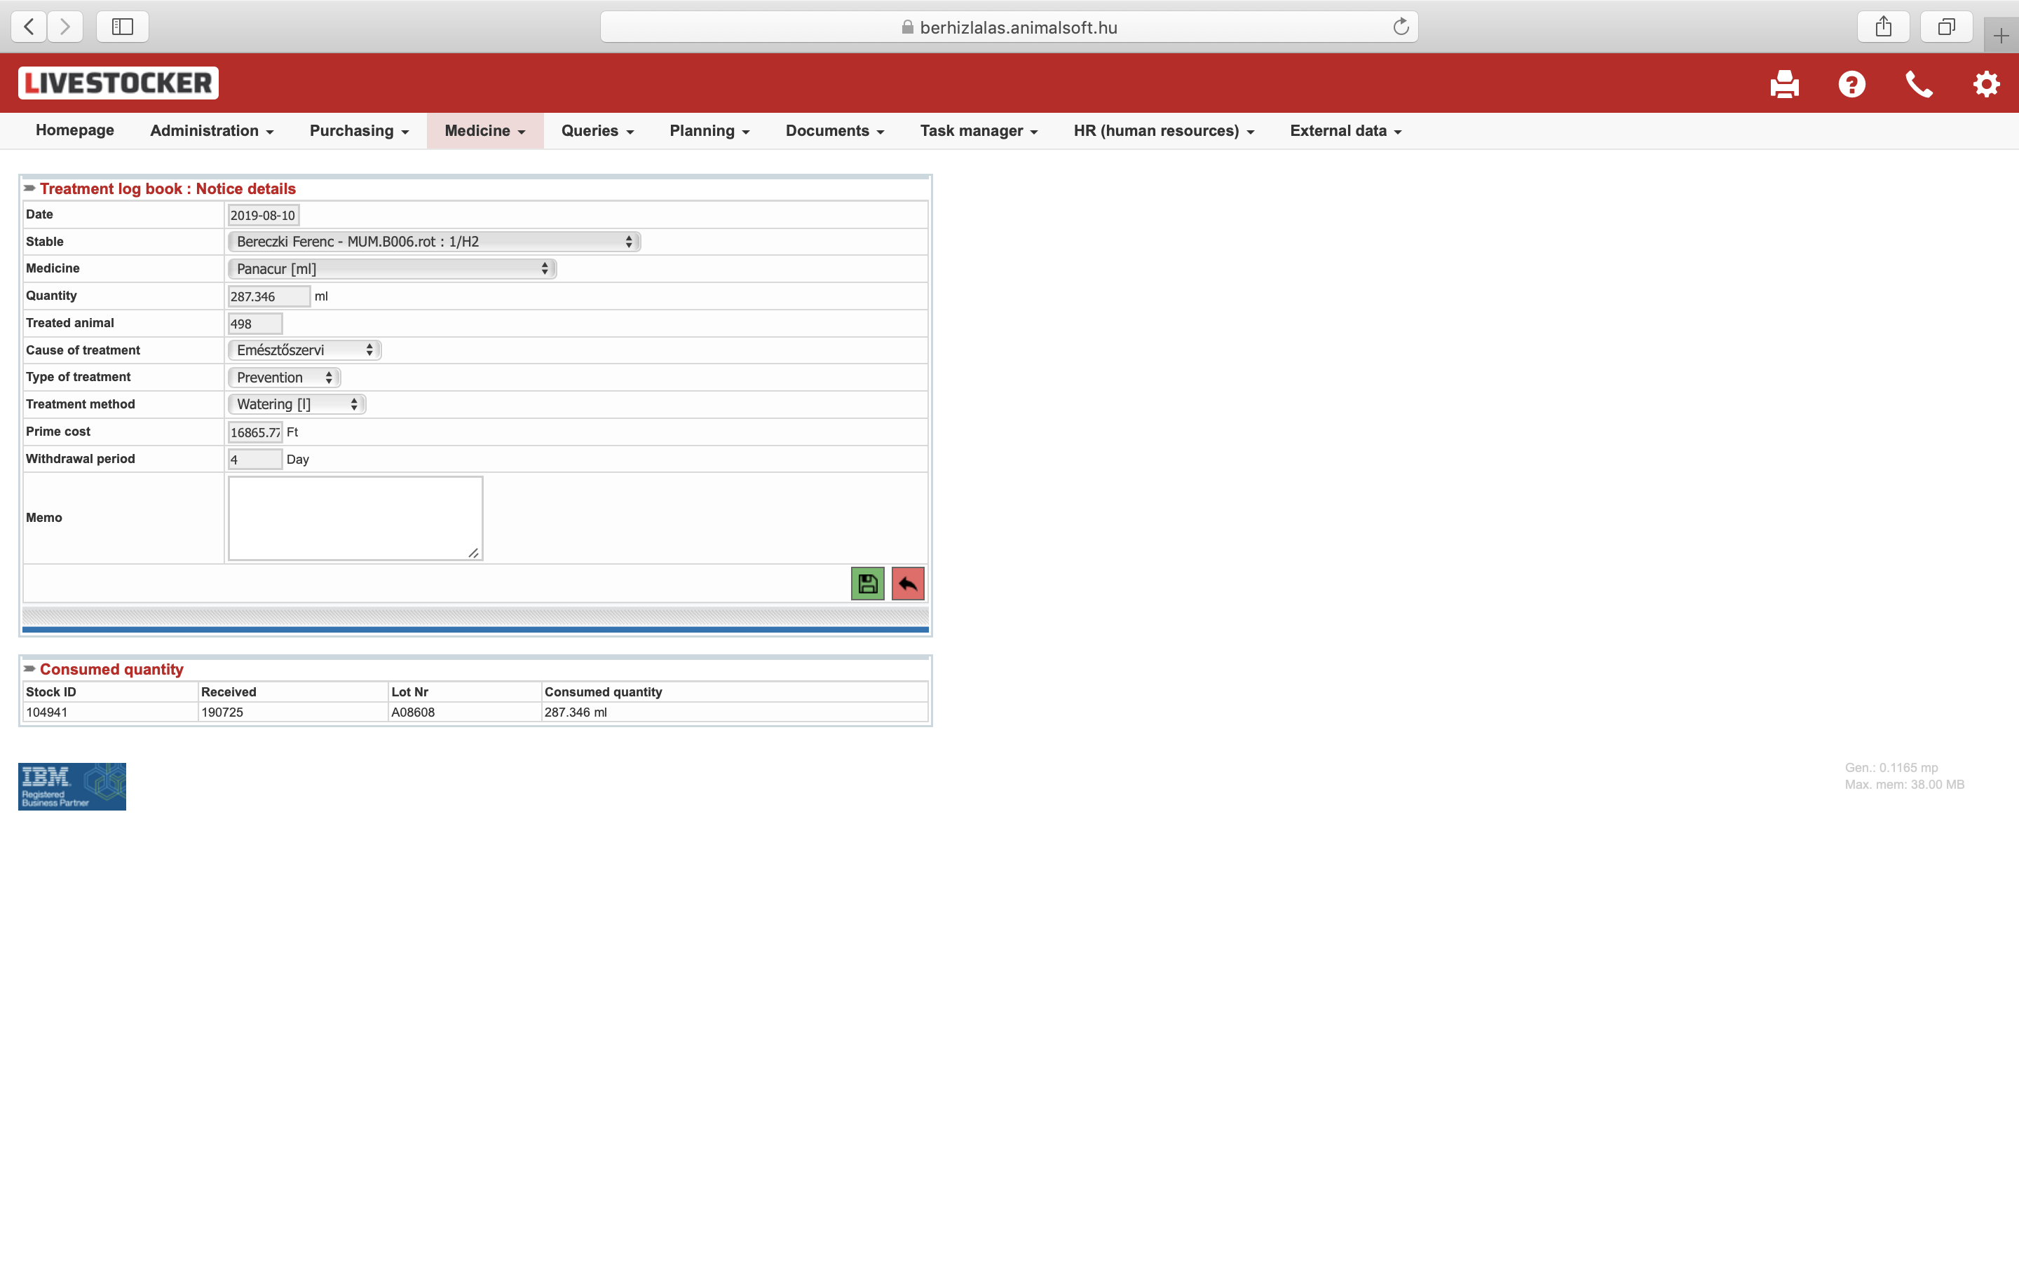
Treatment details
  Period
  Stable
  Nr of animals
  Product / Medicine
  Active ingredient
  Treatment
    Type
    Cause
    Cost
  Withdrawal period
  Amount

Slide 22
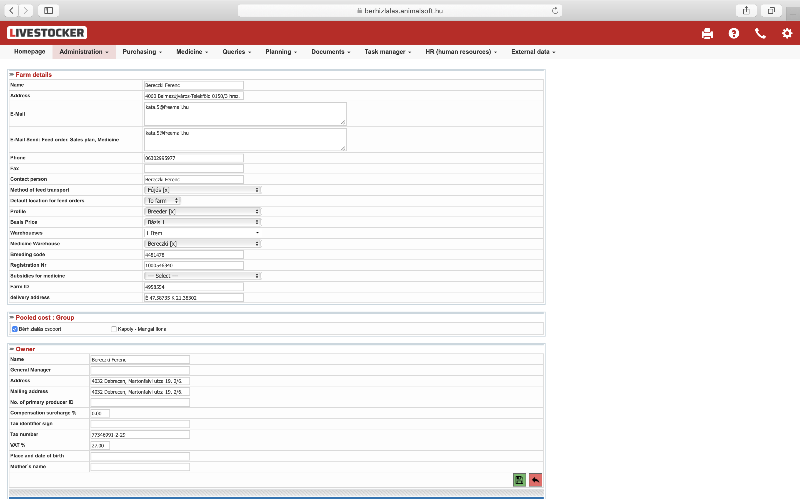
Virtual farm / Database
  Farm
  Stables
  Warehouse
  Silo
  Supplier
  Customer
  Medication
  Feed
  Products

Slide 23
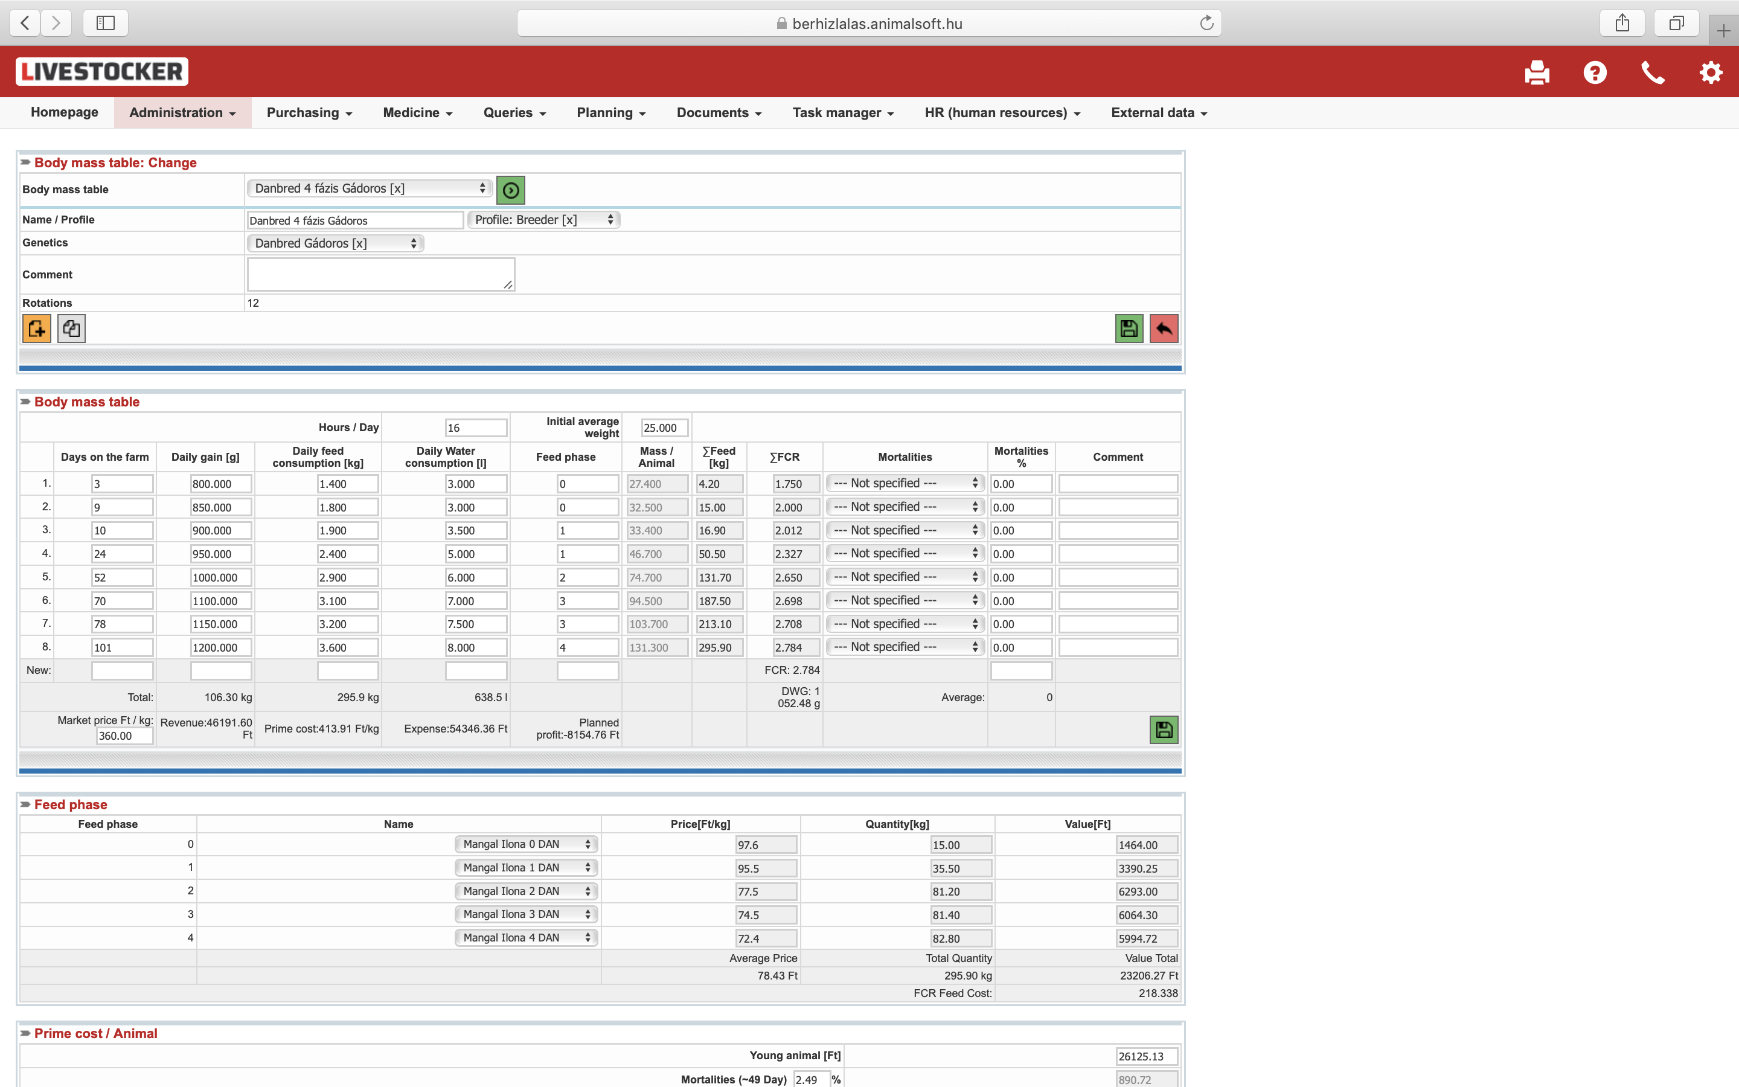
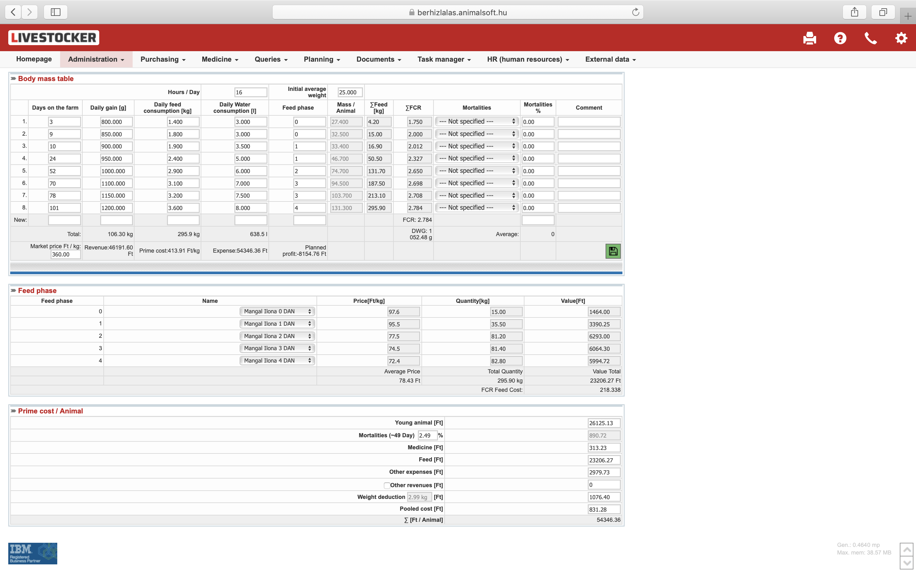
Body mass table
  Breed and stable specific
  ADFI
  ADG
  ADWI
  Feed phases
  FCR
  Mortality
  Financial plan
  Expected income
  Expected profit & loss

Slide 24
Integrated reports
Products and active ingredient used in g and currency
Filters by period, active ingredient, supplier
Active ingredient / 1 unit of product
Interpretation of Mortality and medication

Slide 25
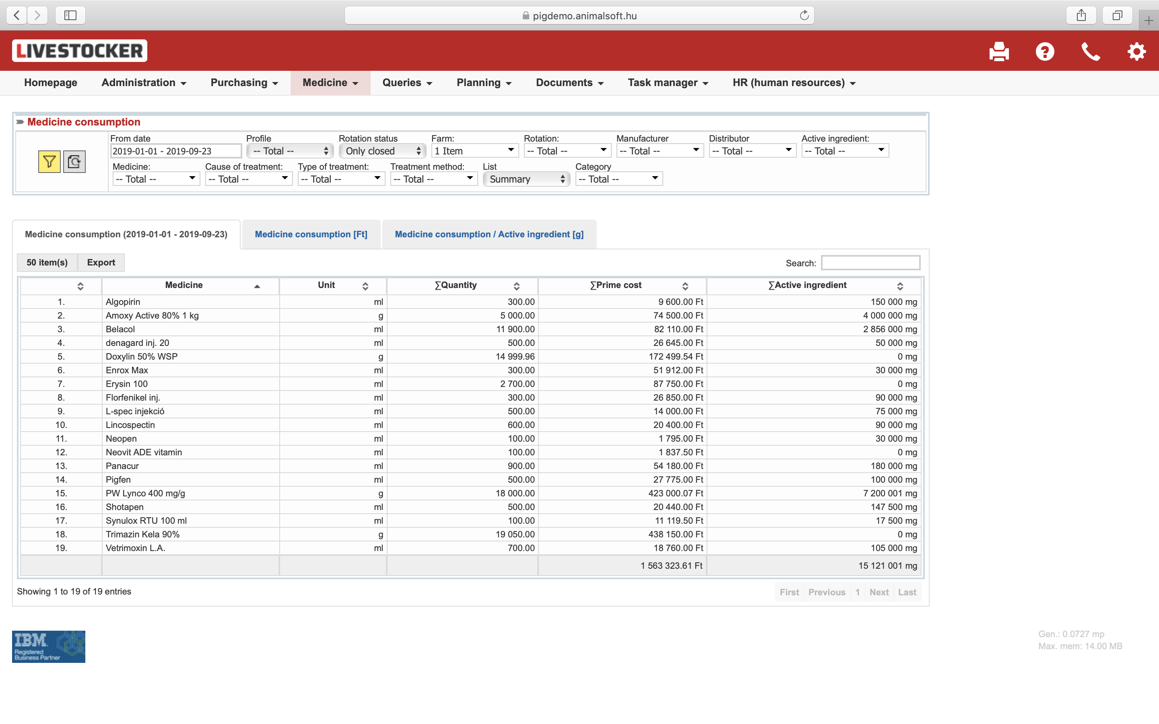
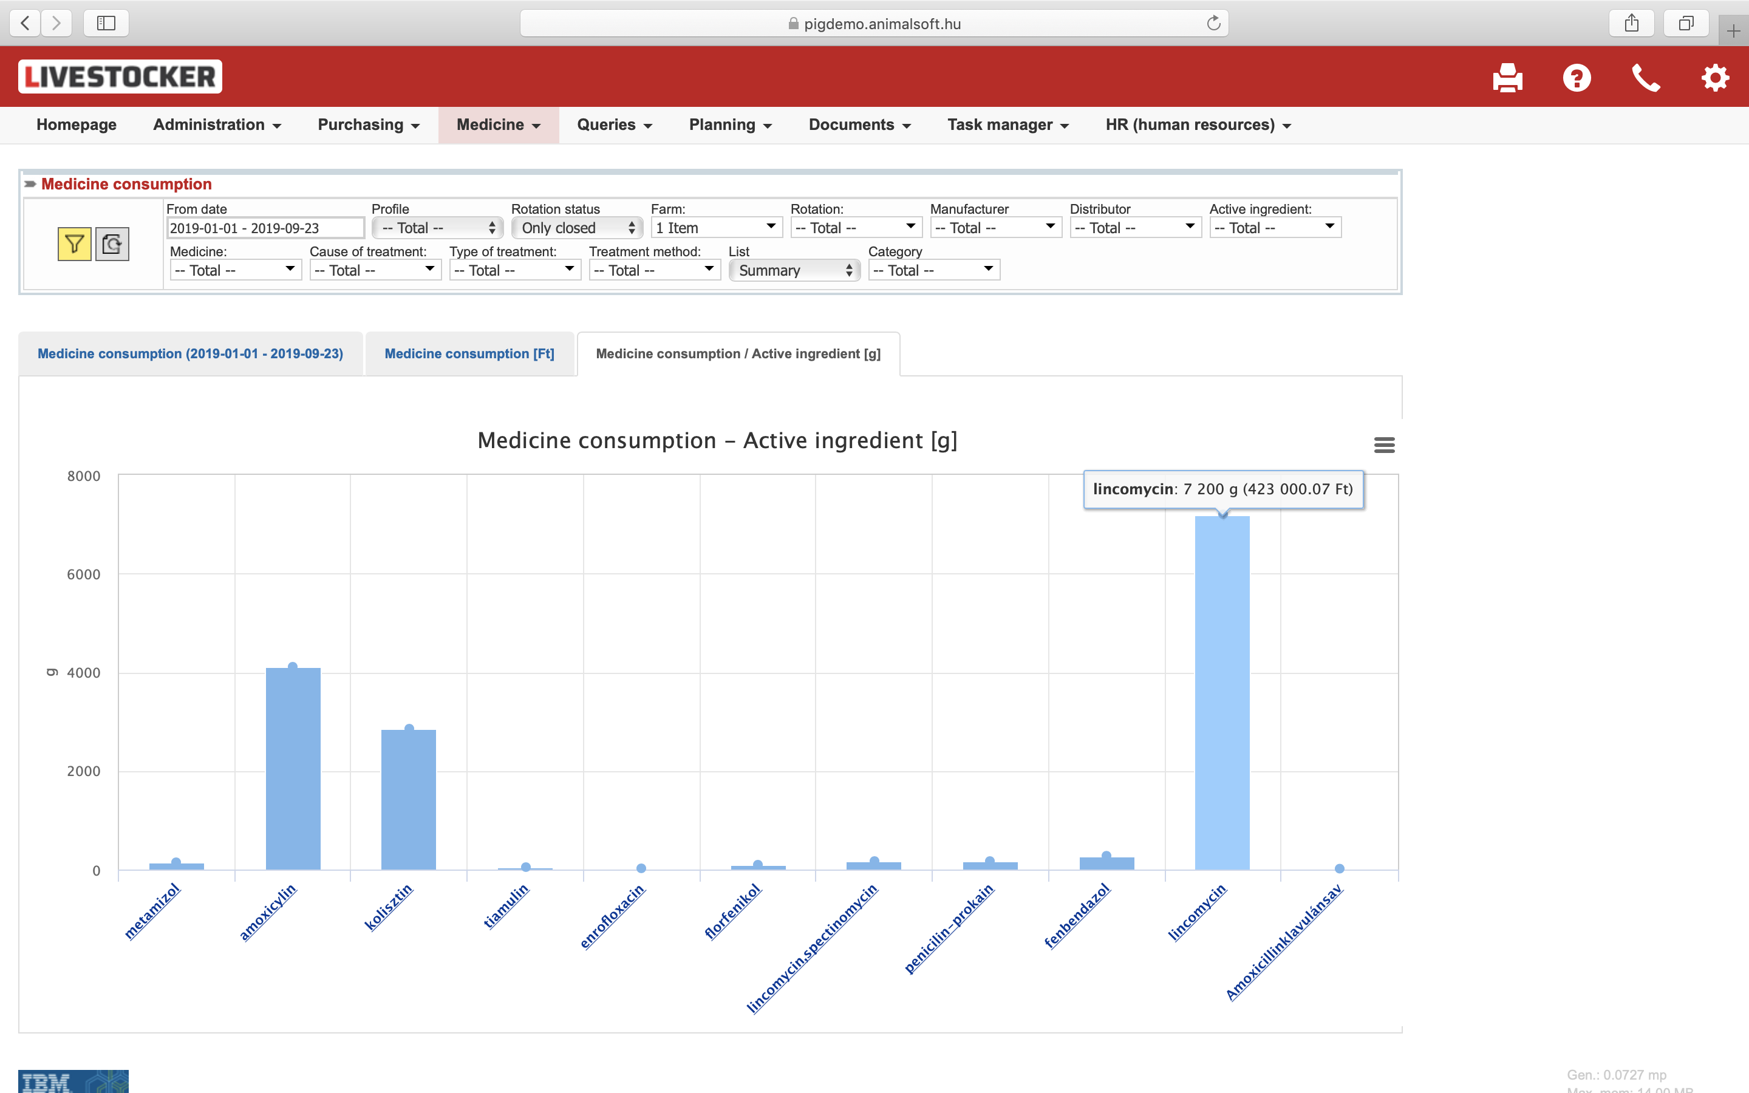
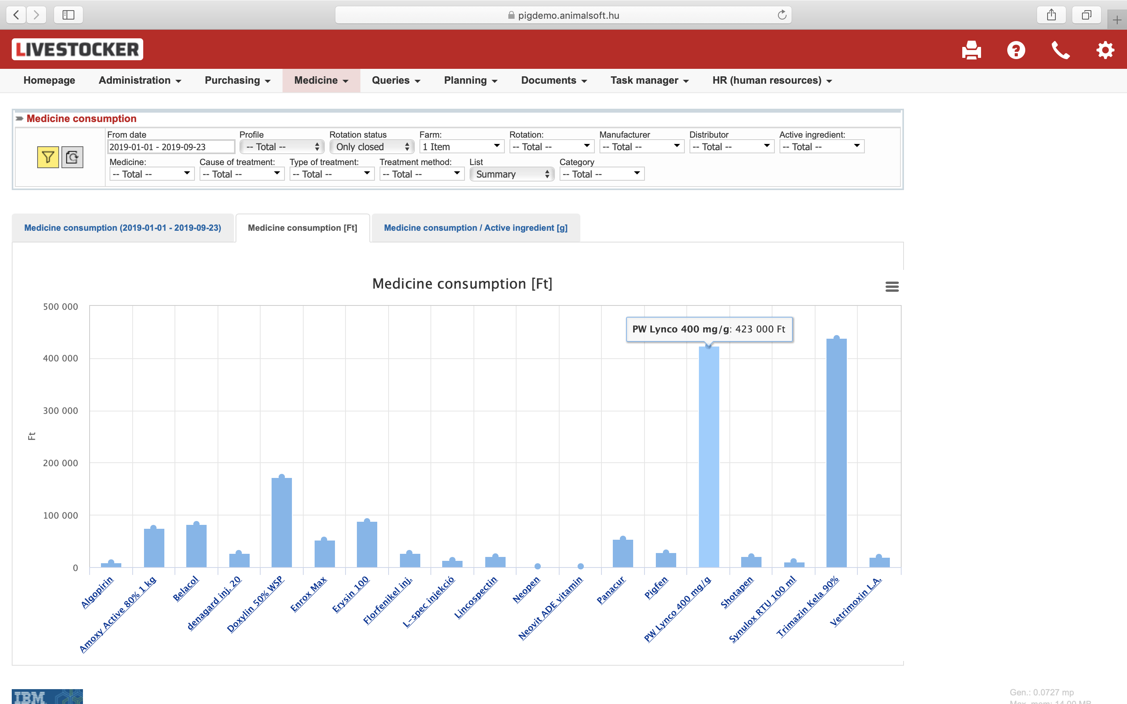
Medicine consumption
(Period)
  farm, rotation
  Supplier, Active ingredient
  Cause of treatment
Medicine consumption
(Total)
  Active ingredient
Medicine consumption
(Active ingredient)

Slide 26
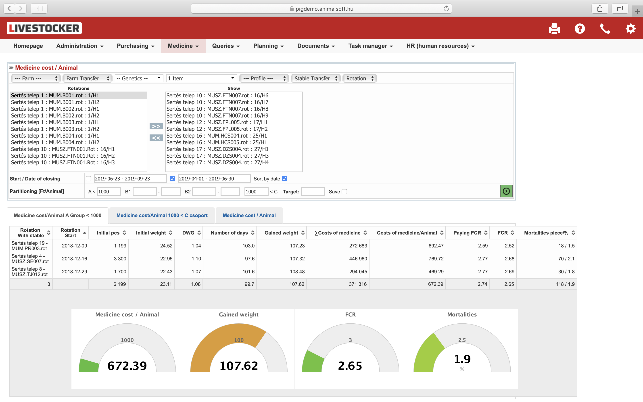
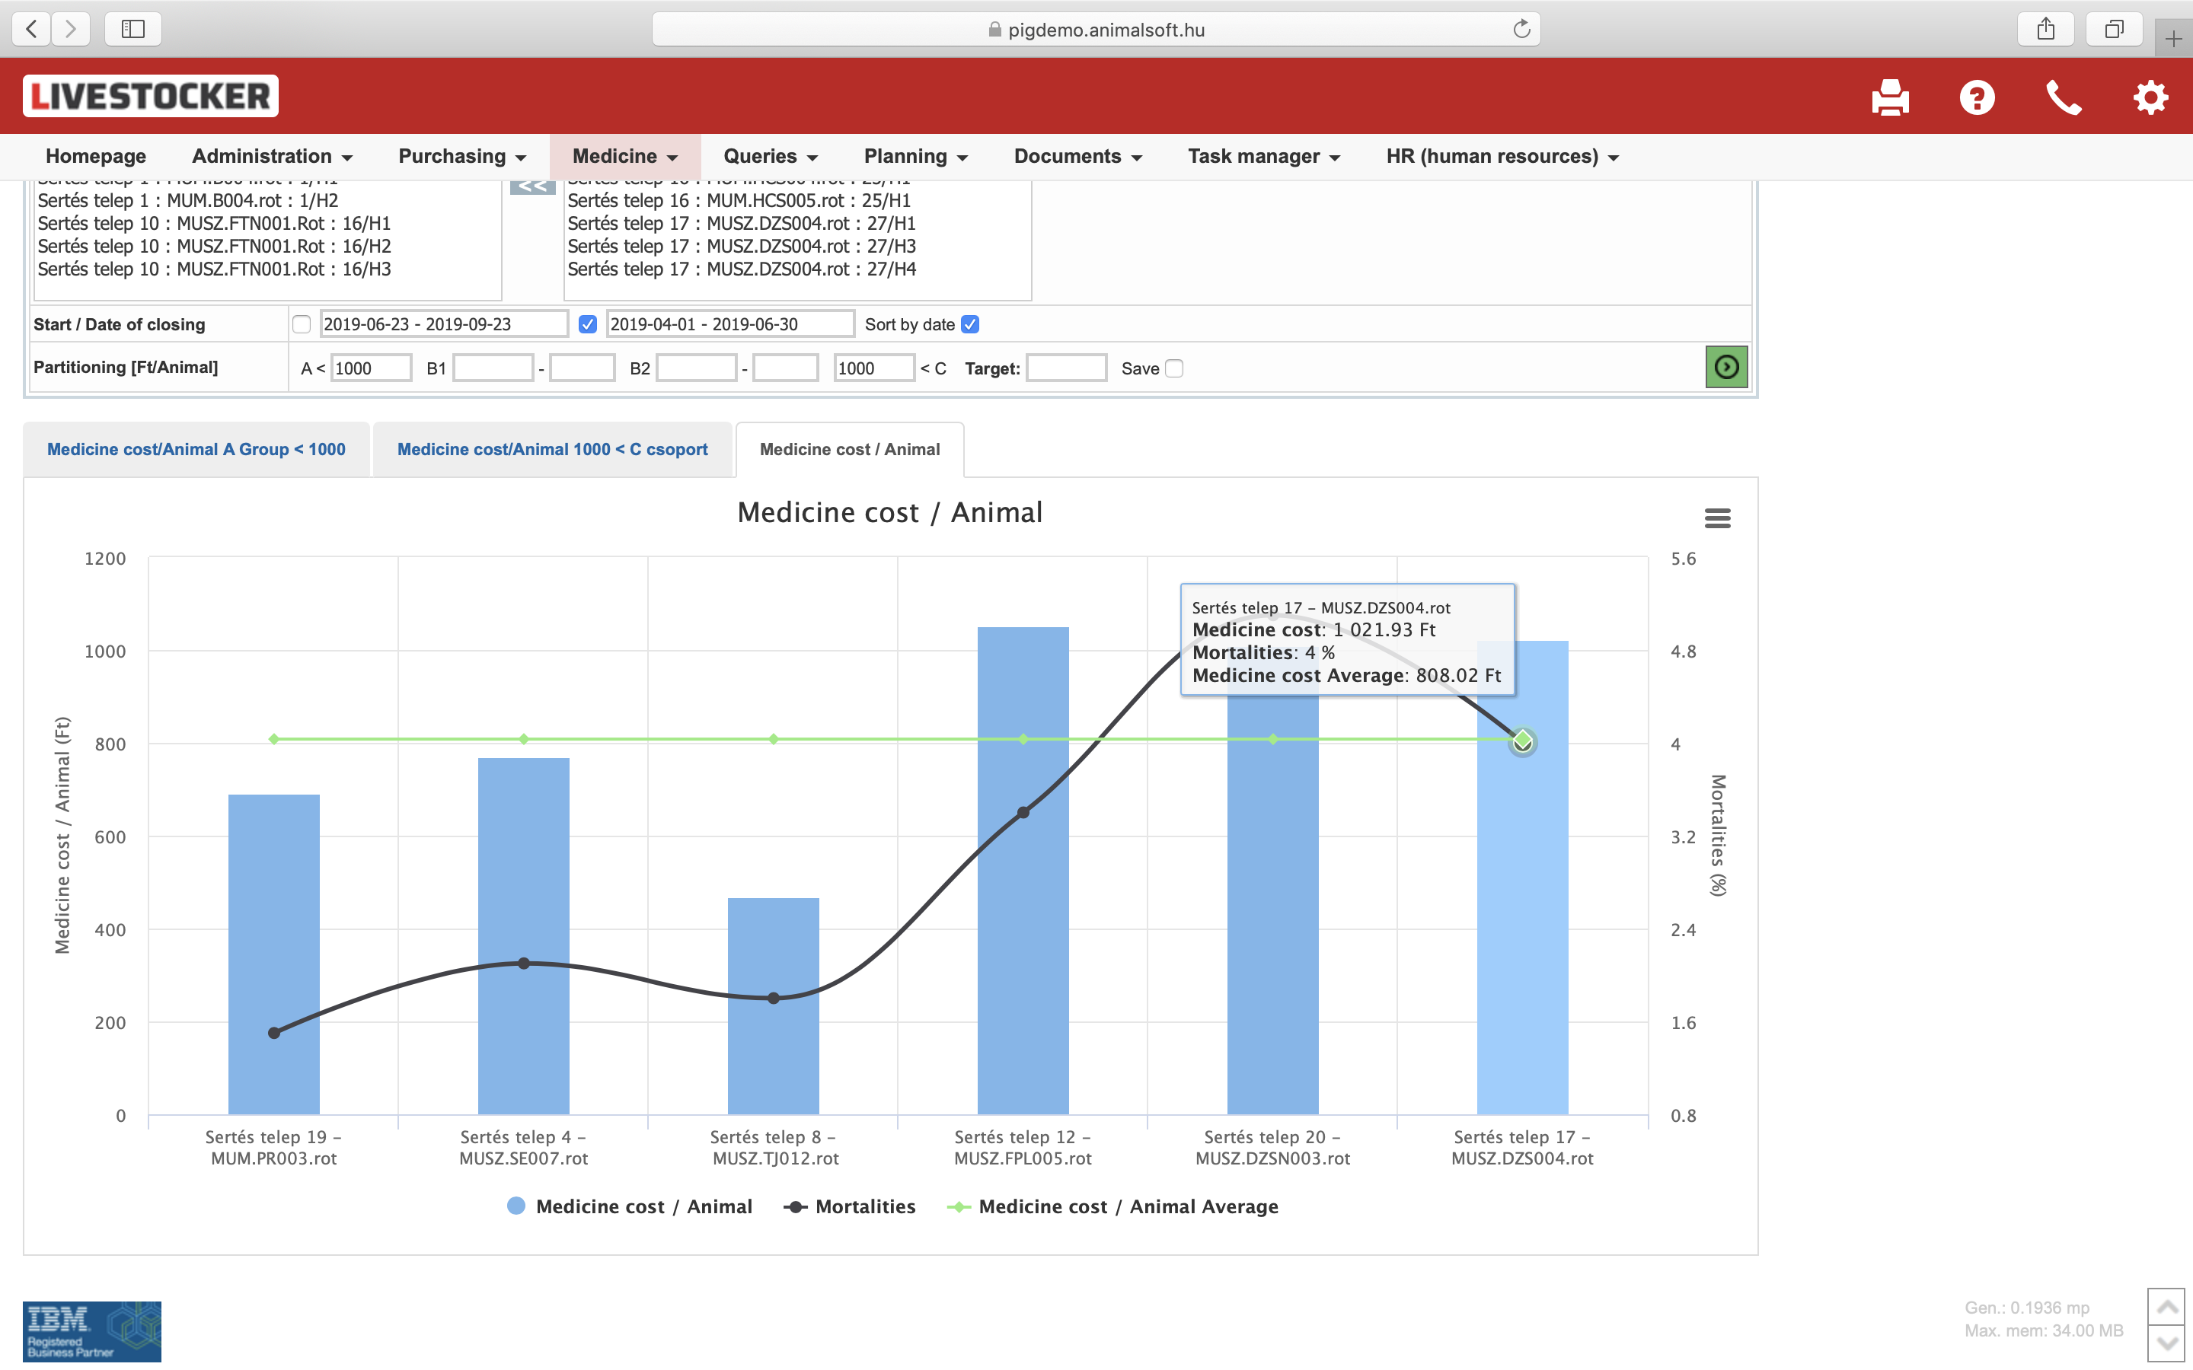
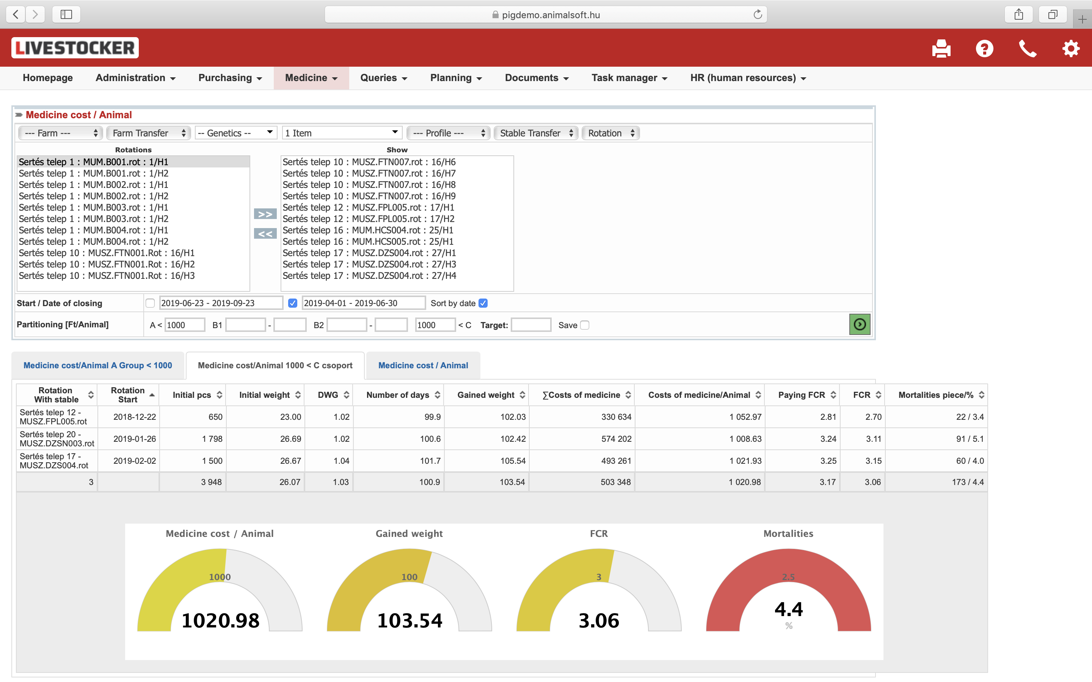
Medicine cost / animal
(<1000 HUF; >1000 HUF)
  farm, rotation, breed
  period
  Cost
Medicine cost / animal
(graph)
  Active ingredient

Slide 27
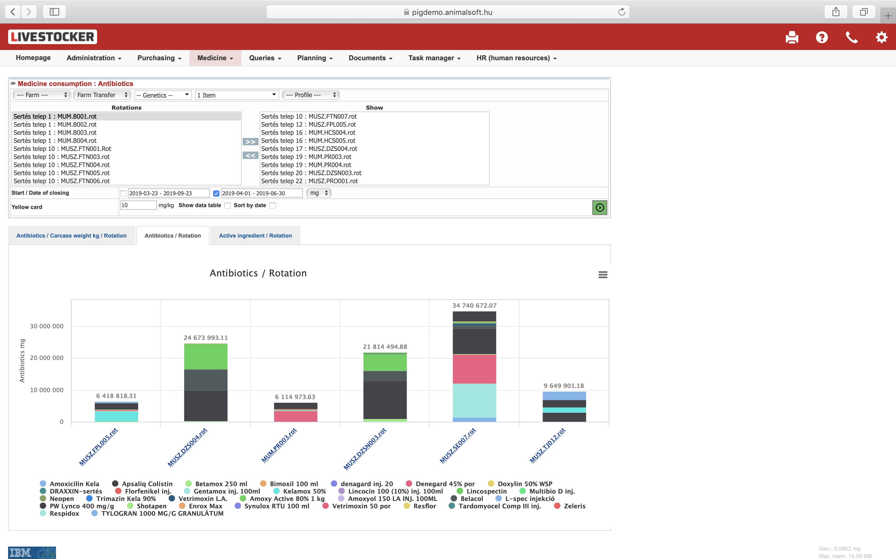
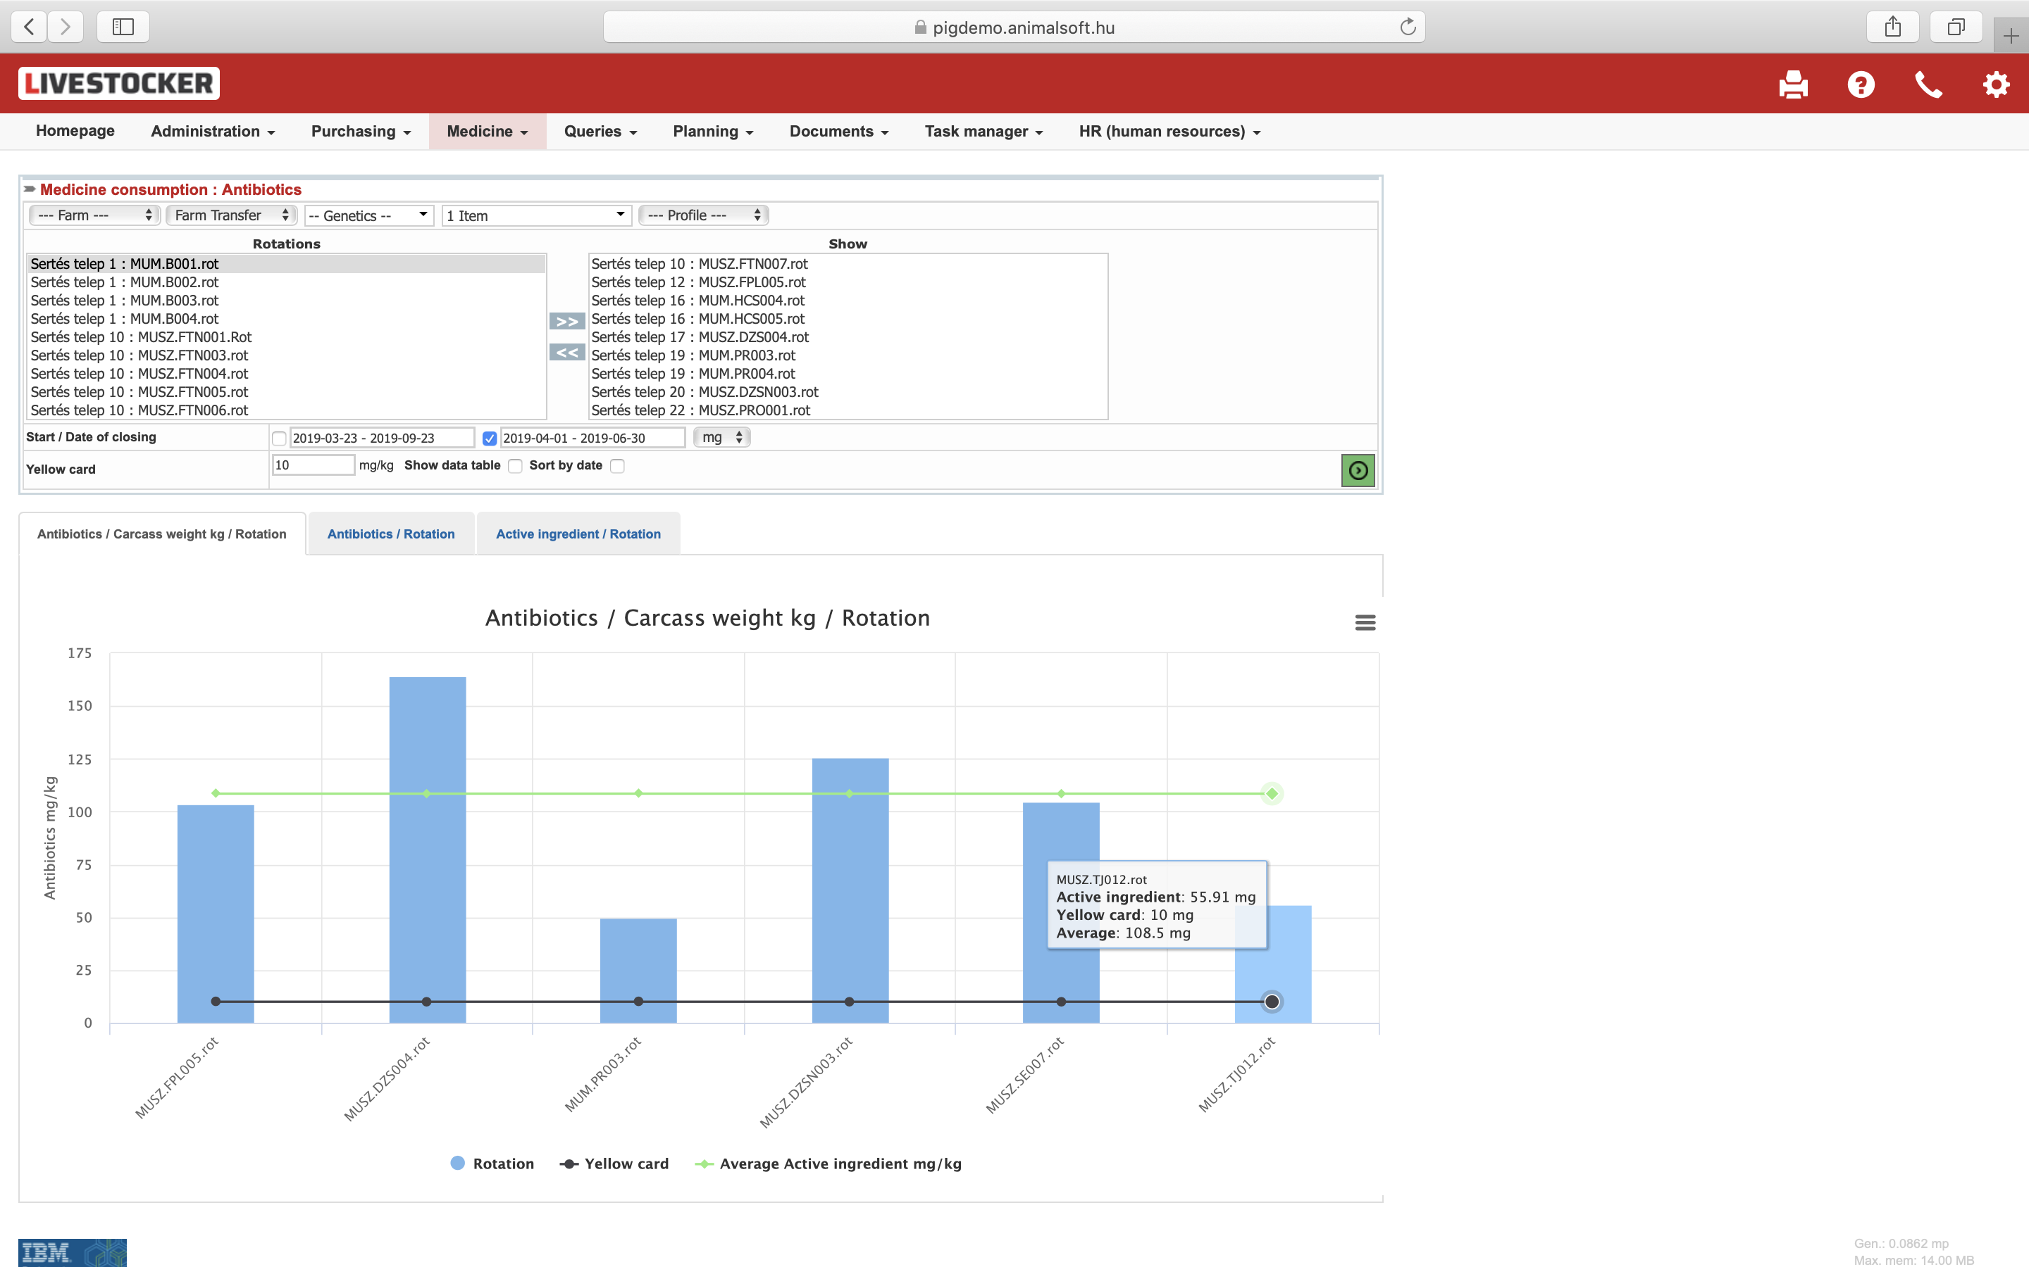
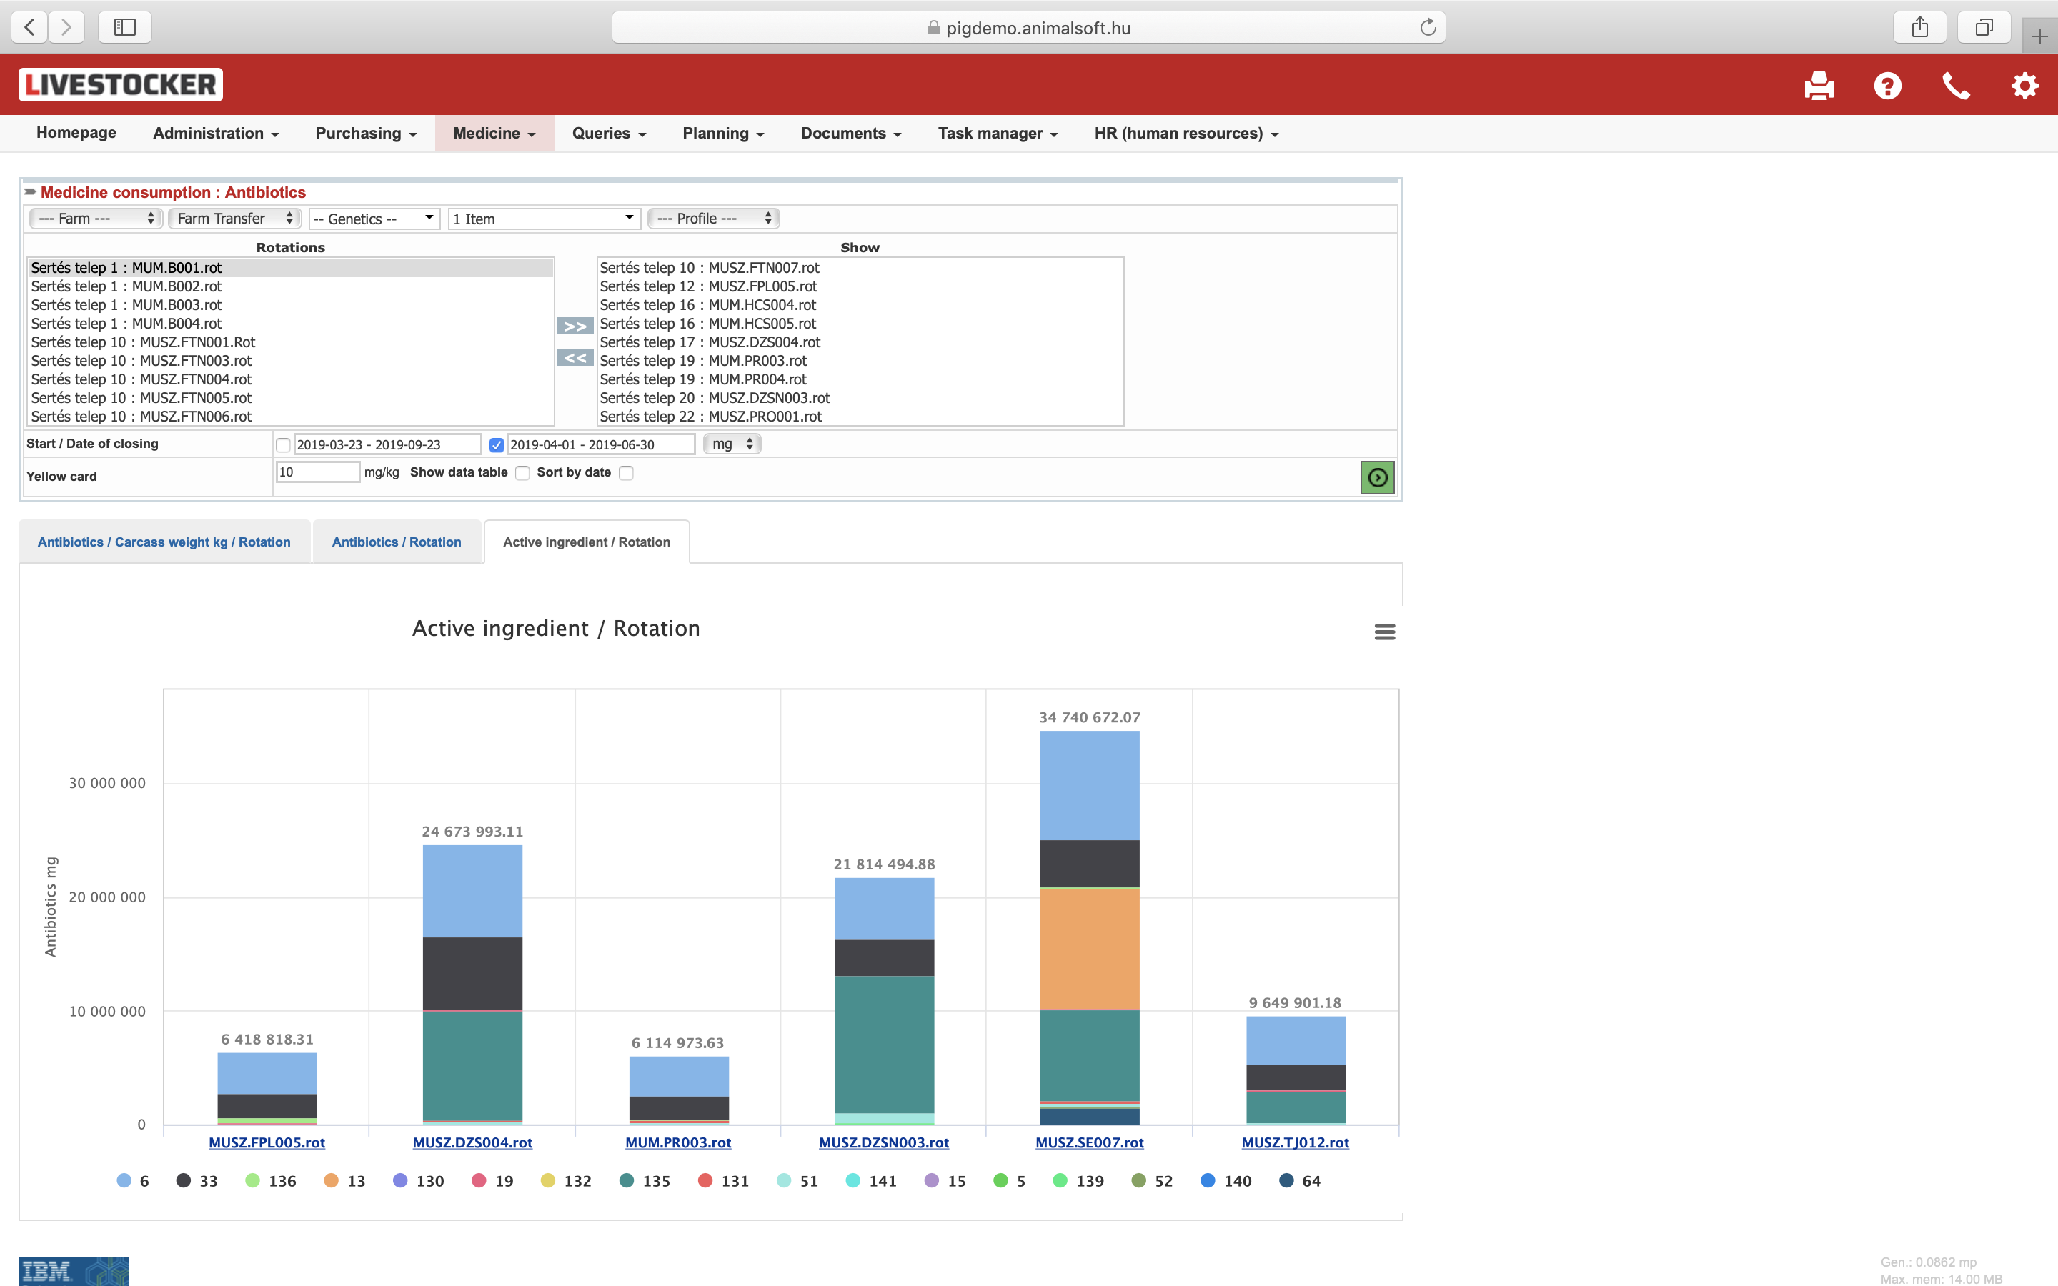
Medicine consumption
(1 unit / product)
  Farm
  Breed
  Period
  Rotation
  Antibiotics / rotation
  Active ingredient / rotation

Slide 28
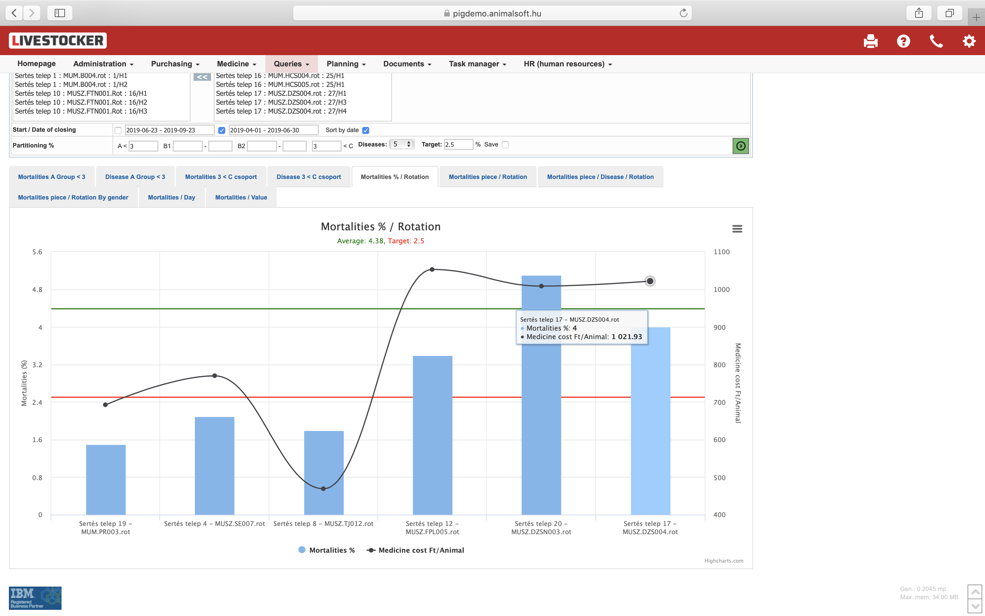
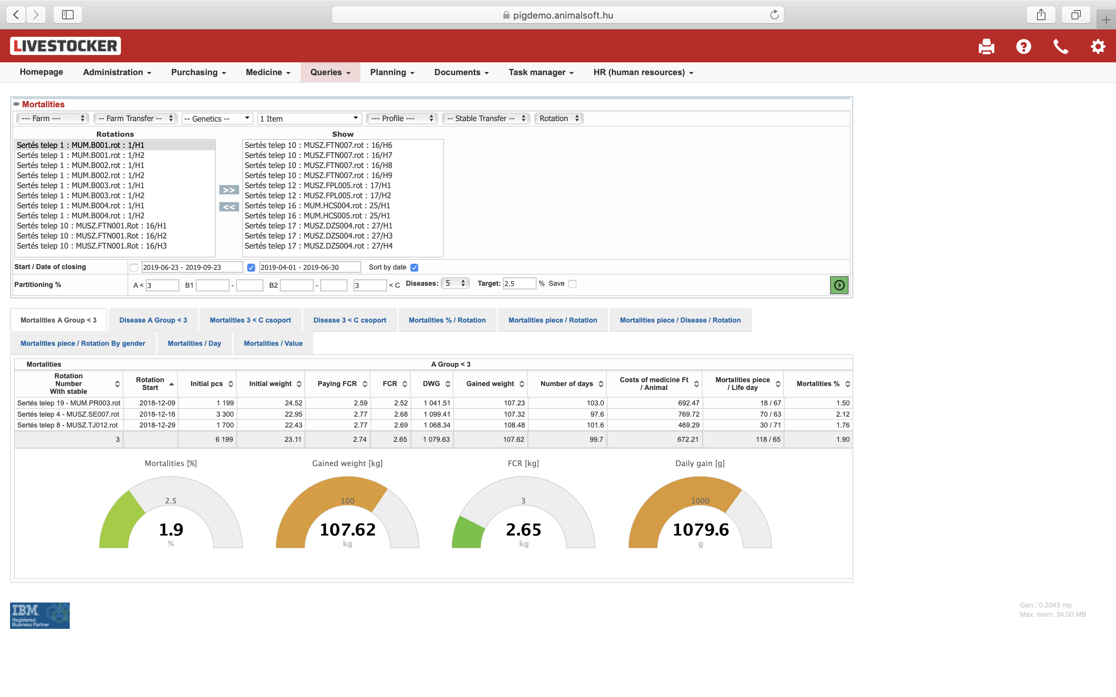
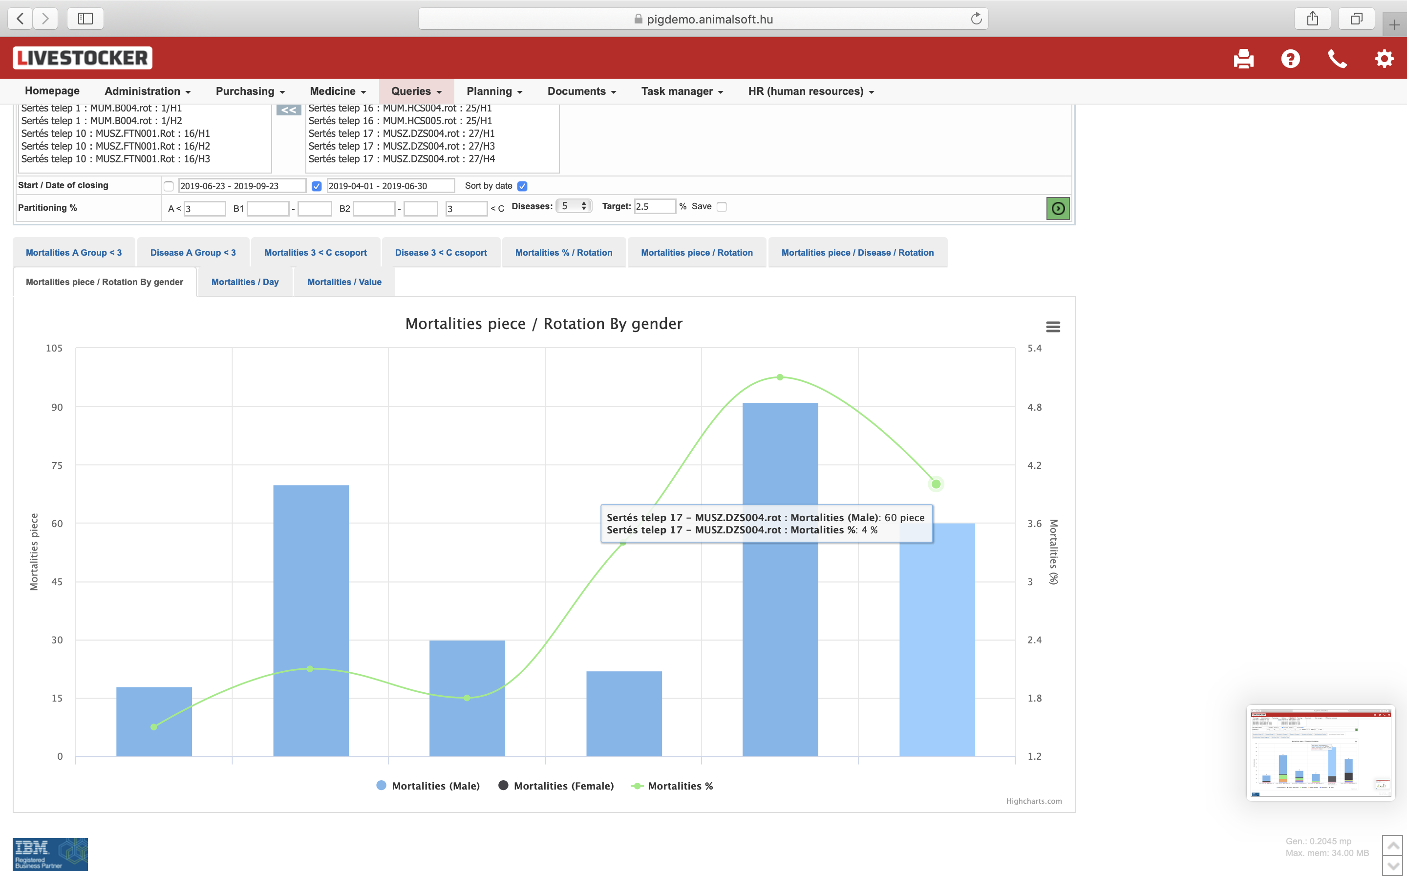
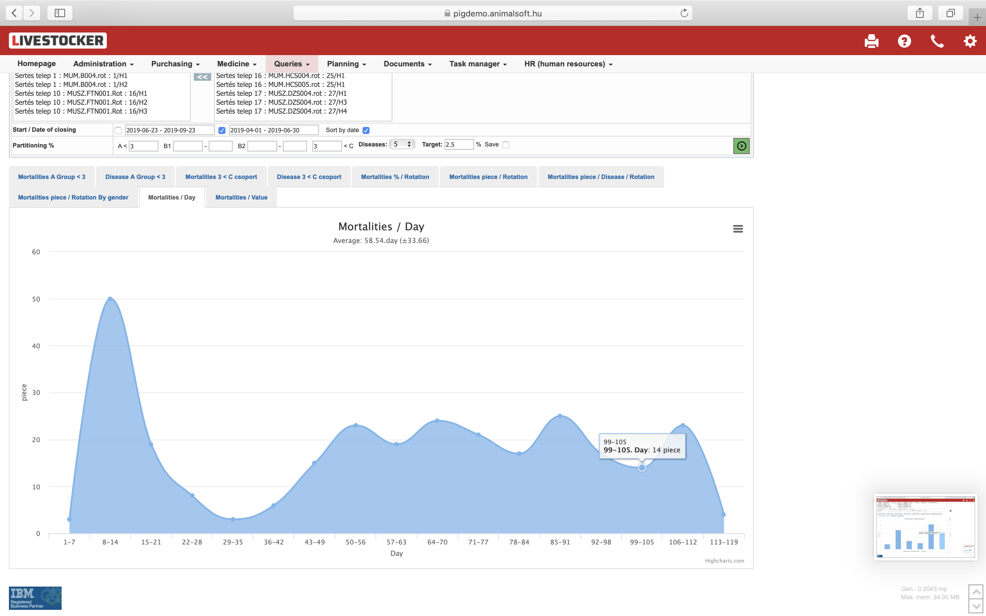
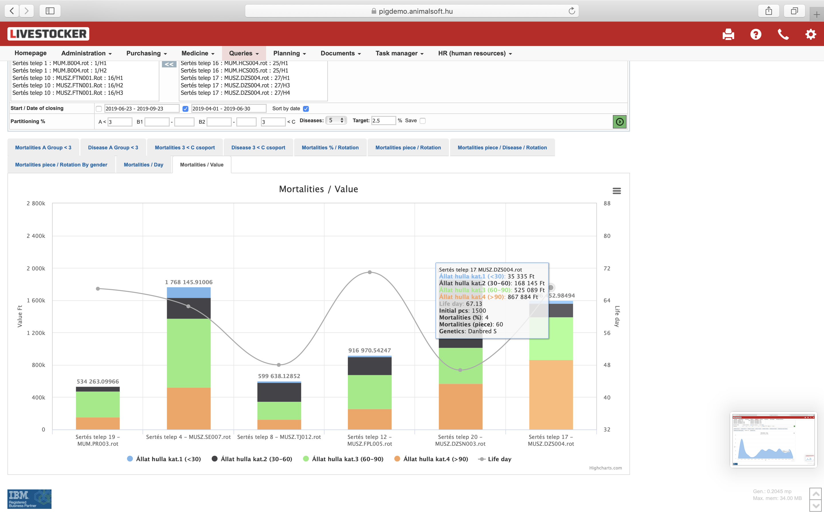
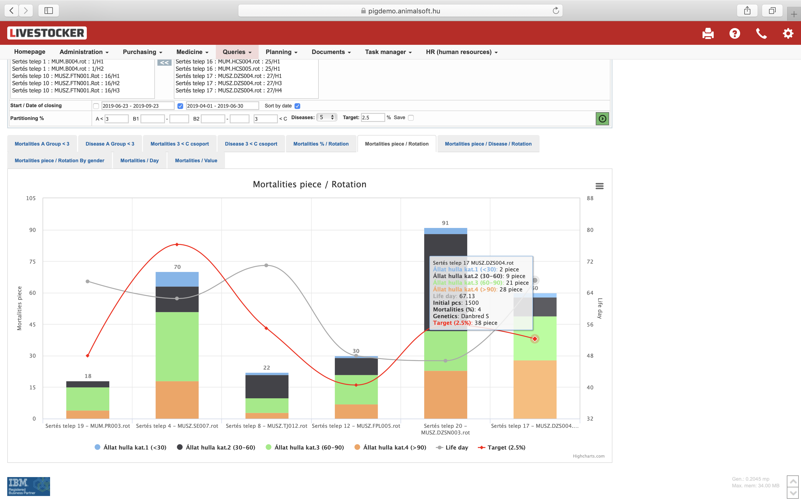
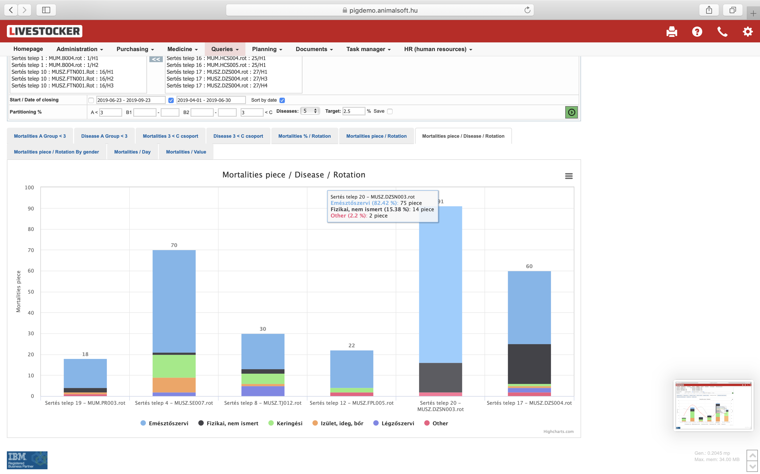
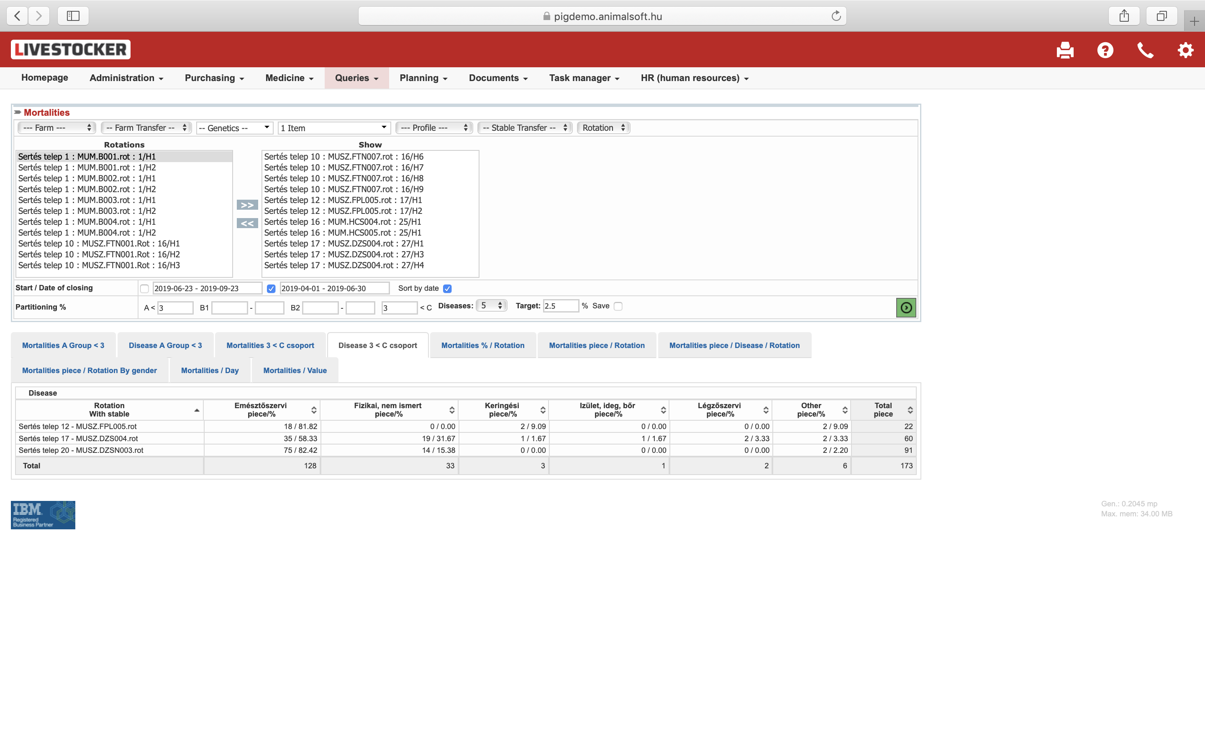
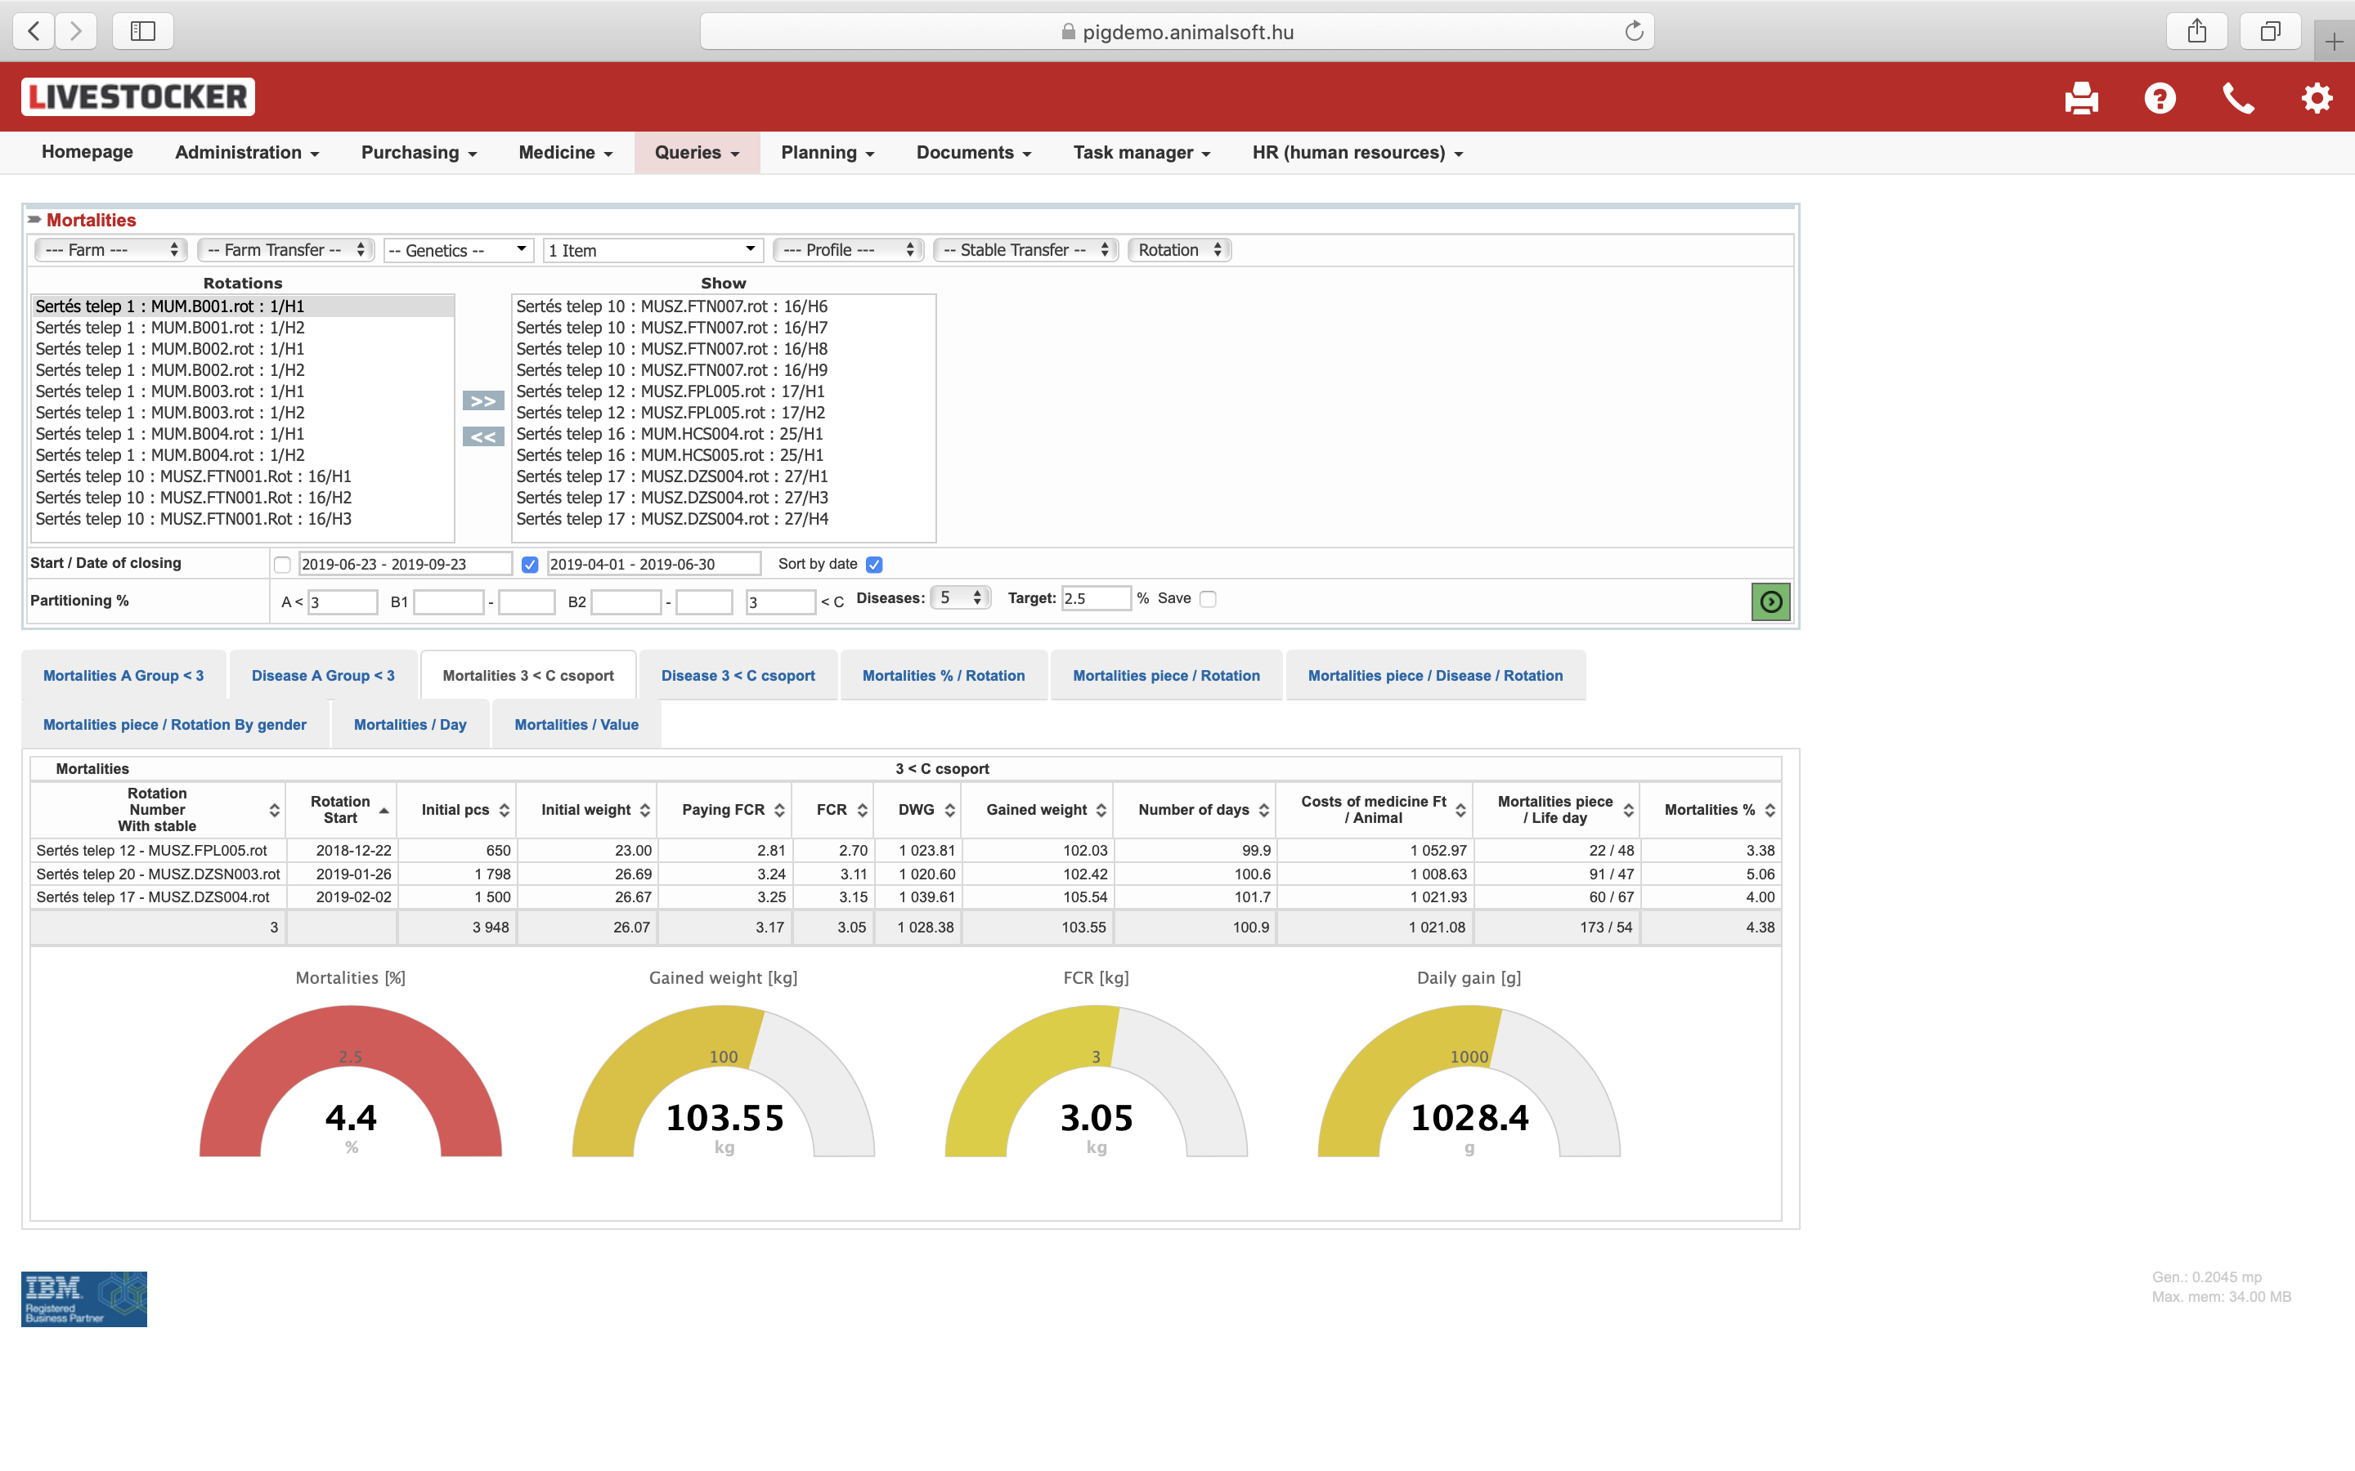
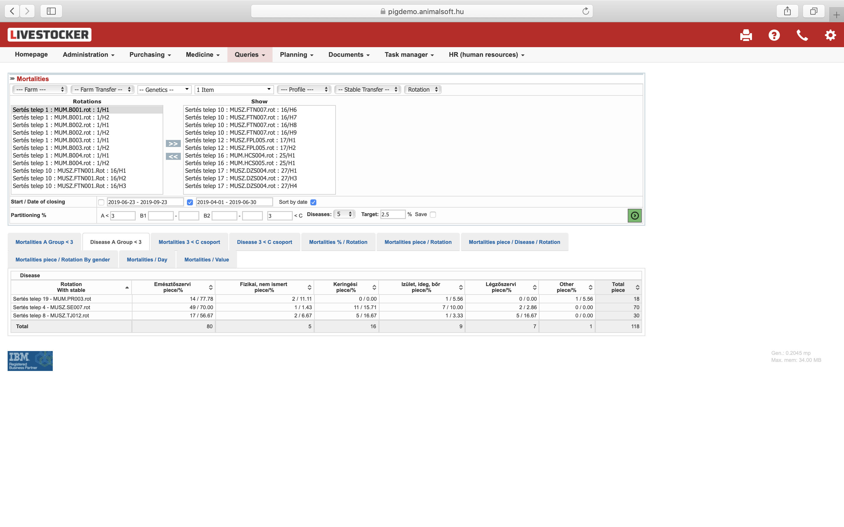
Interpretation of health
Farm
Breed
Breed
Period
  Production KPI
  Cause of mortality
  Mortality / rotation
  Mortality/disease/rotation
  Mortality by gender
  Mortality / day
  Mortality (value)

Slide 29
Value based corporate culture
All KPI translated into financial impact
Benefits & returns
Strategic importance
More efficient procurement
Competition among suppliers
Production efficiency
Lowering antimicrobial use
Lower mortality
Higher growth rate
Lower feed conversion
Brainstorming
Strategy
Education
Up to
+10 %
EBIDTA
Vision
Solution
Less administration
Higher efficiency in work
Automated reports
New idea
Strategic decisions
Decisions based on facts
Interpretations
User rights
Only relevant parts are accessible
Few clicks and data turns into information

Slide 30

Precísion Livestock Farming
Next big step forward is making decision based on real time data to cross borders for sustainability and profit
Running out of time….
Who, What, Why, When and How?
Farm management
Sofisticated technology standards, but the circumstances are not standard at all
12
11
1
10
2
Breeds and farm technology are already available, only matter of return on investment if it is applicable for production.
SMART tools
Without organized, structured data, expensive gadgets ?
9
3
8
4
Farm technology
Permanent ideal environment for healthy growth
7
5
6
Robustness and animal health
Robust genetics
Animal Health Status, prevention

Slide 31
Unlimited farms and users
(applicable for authorities)
01. Data export – Import
02. Automatic reports – internal and government authorities
03. Data import SMART - IOT

